Slide 1

EECS E6893 Big Data Analytics Intro to Big Data Analytics on GCP
Rui Chu, rc3414@columbia.edu

Slide 2
Agenda
GCP
Setup
Interaction
Services
Cloud Storage
BigQuery
Dataproc (Spark)
HW0

Slide 3
GCP
Cloud computing platform
Flexibility: on-demand and scale as you want
Efficiency: no need to maintain infra
Services (relevant to this assignment)
Compute
Compute Engines: VMs / Servers (automatically created by Dataproc)
Big data products
BigQuery: Data warehouse for analytics
Dataproc: Hadoop and Spark
Storage
Cloud Storage: Object storage system
Much much more at https://cloud.google.com/products/

Slide 4

Google Cloud Platform (GCP)

Slide 5
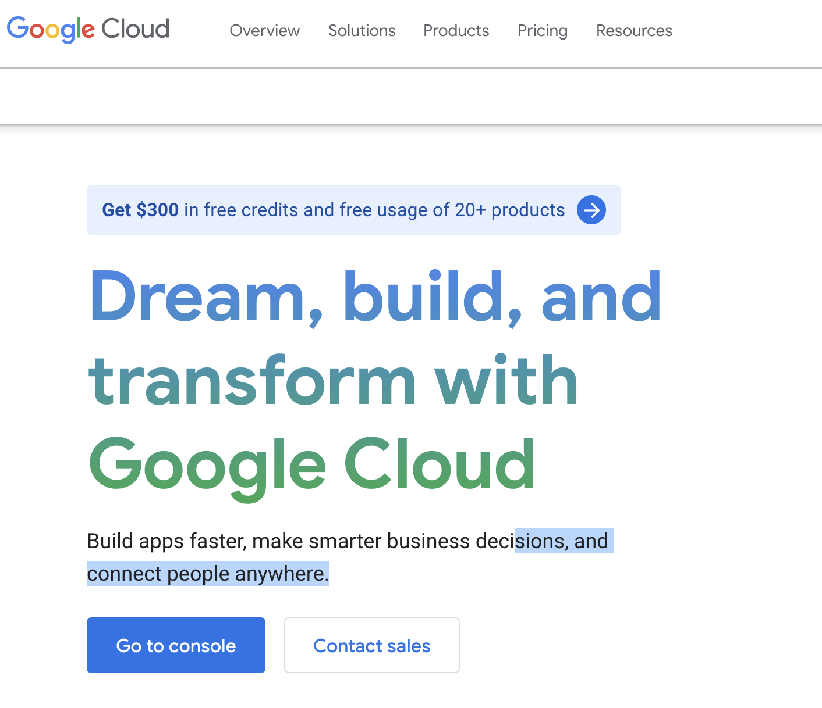

GCP Setup
Create a google account
Apply for $300 credit for the first year: https://cloud.google.com/free/
Go to Console dashboard -> Billing to check credit is there

Slide 6
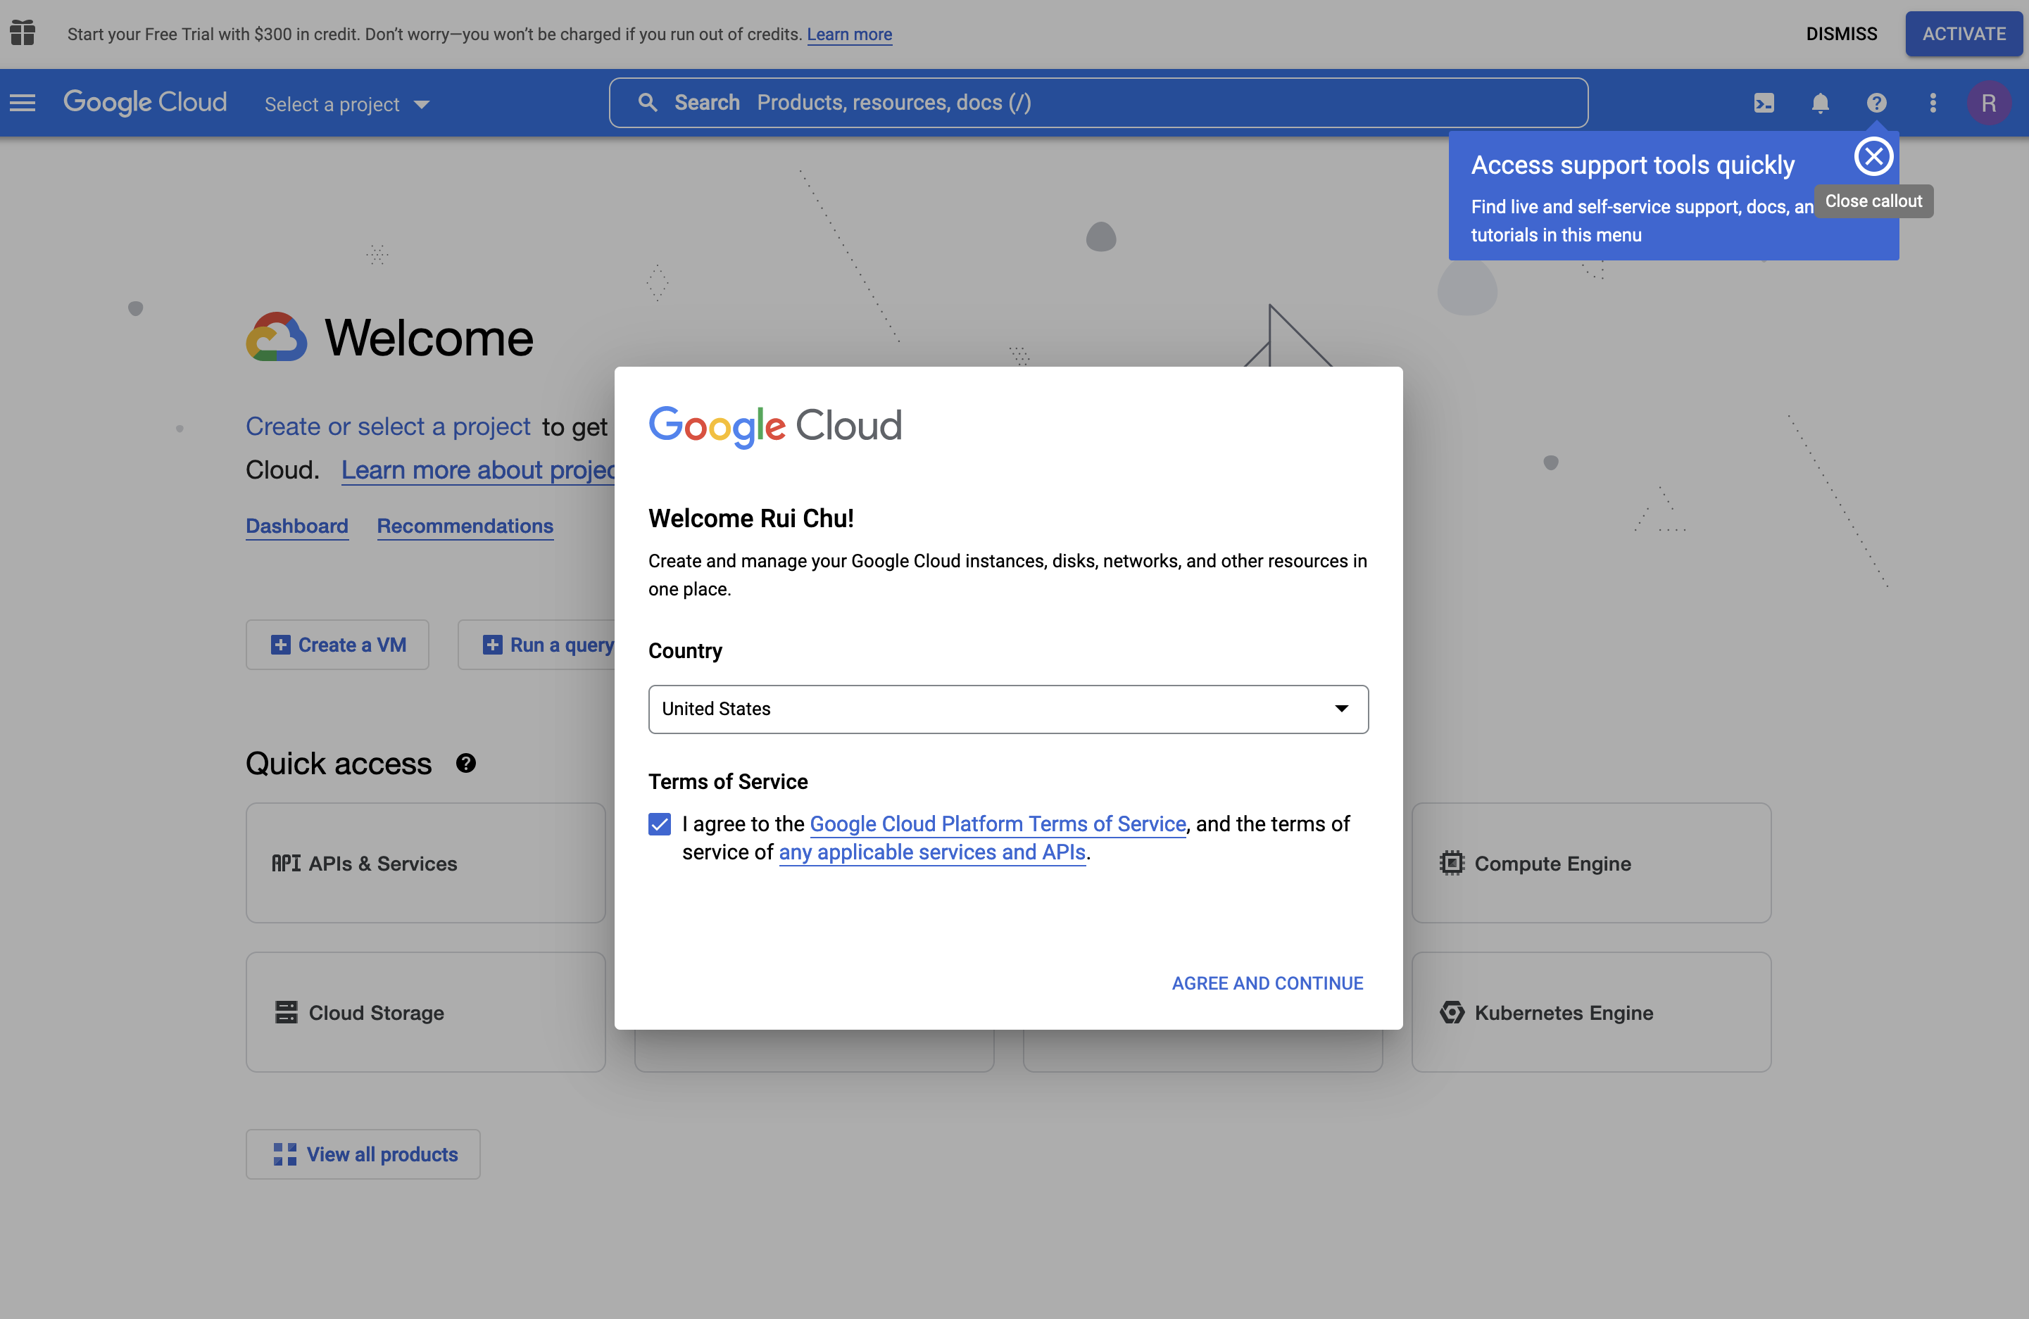


Slide 7
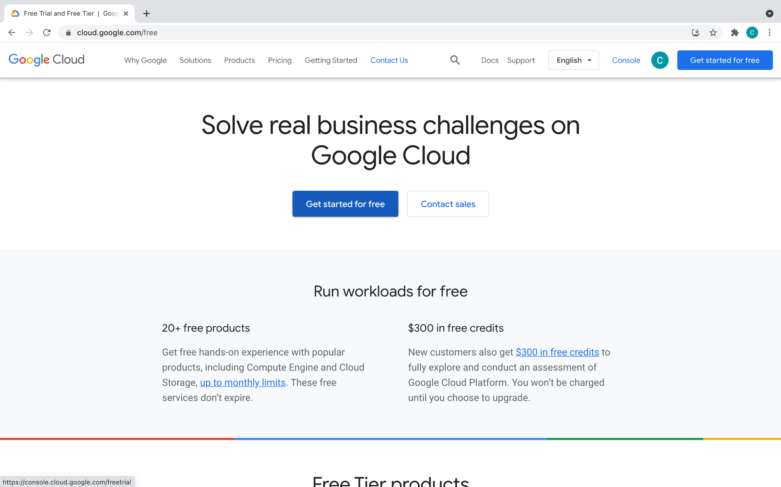

Slide 8
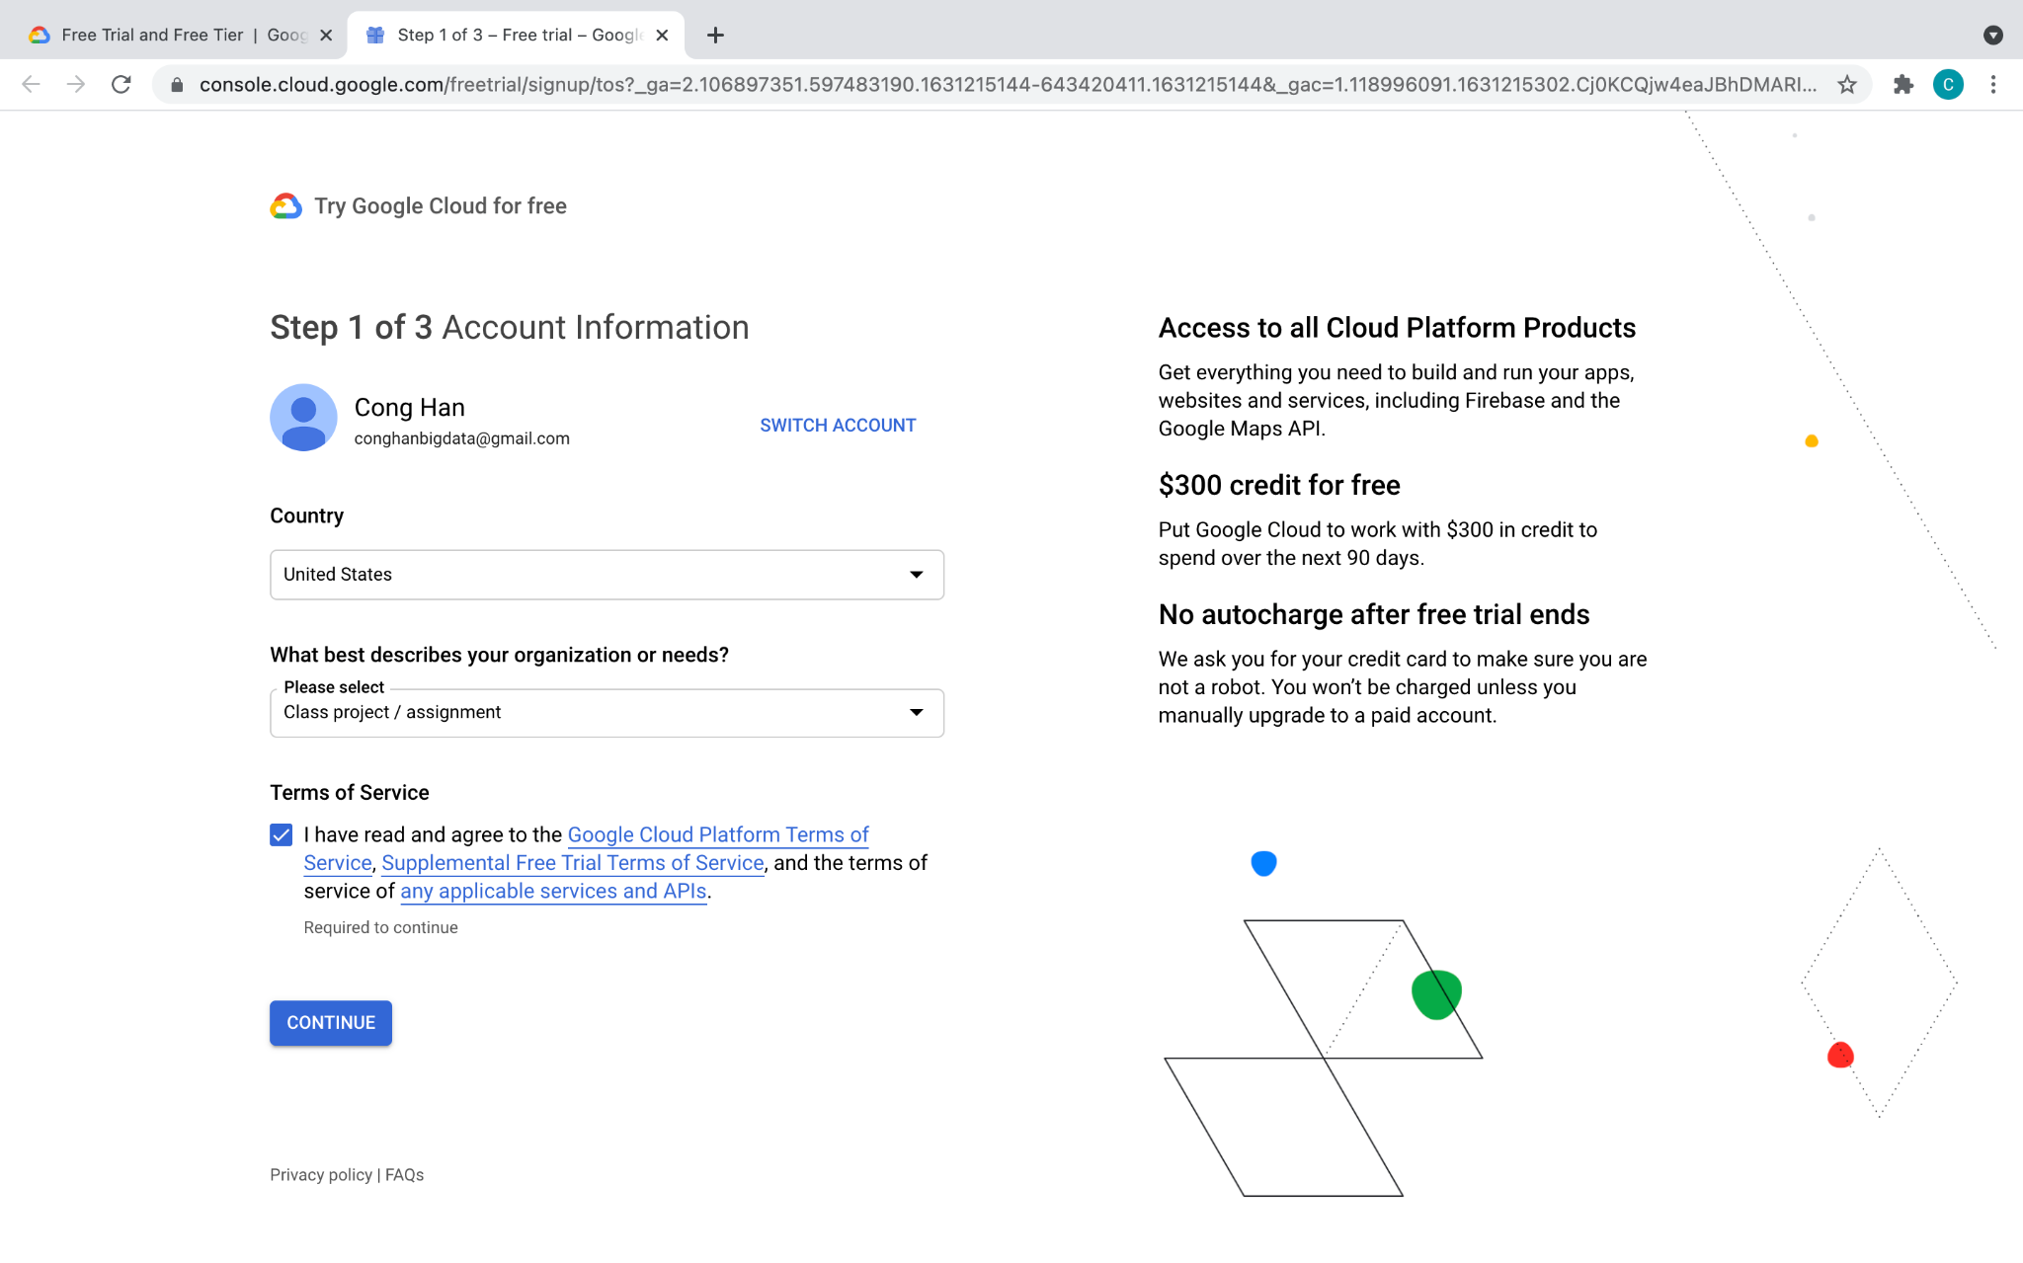

Slide 9
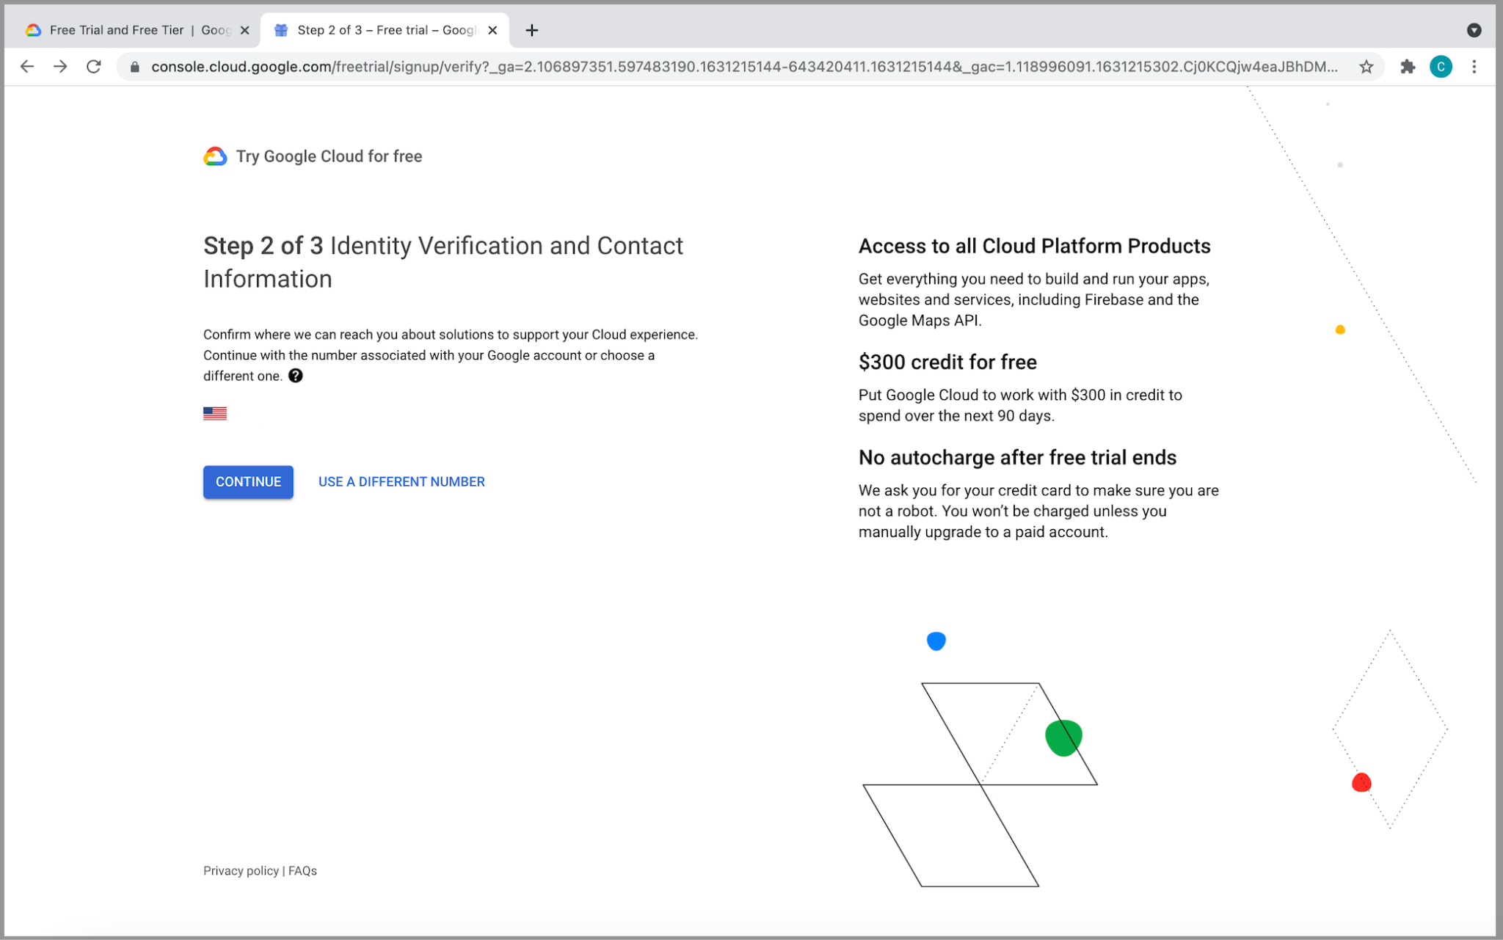

Slide 10
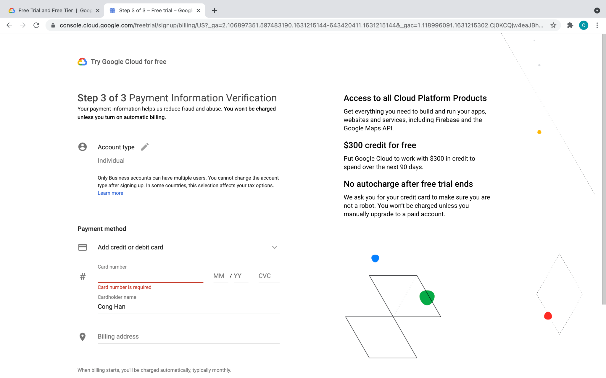

Slide 11
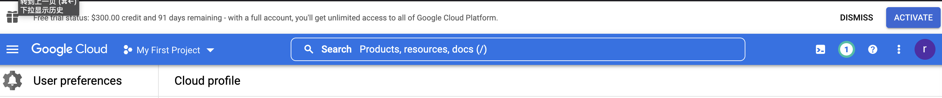
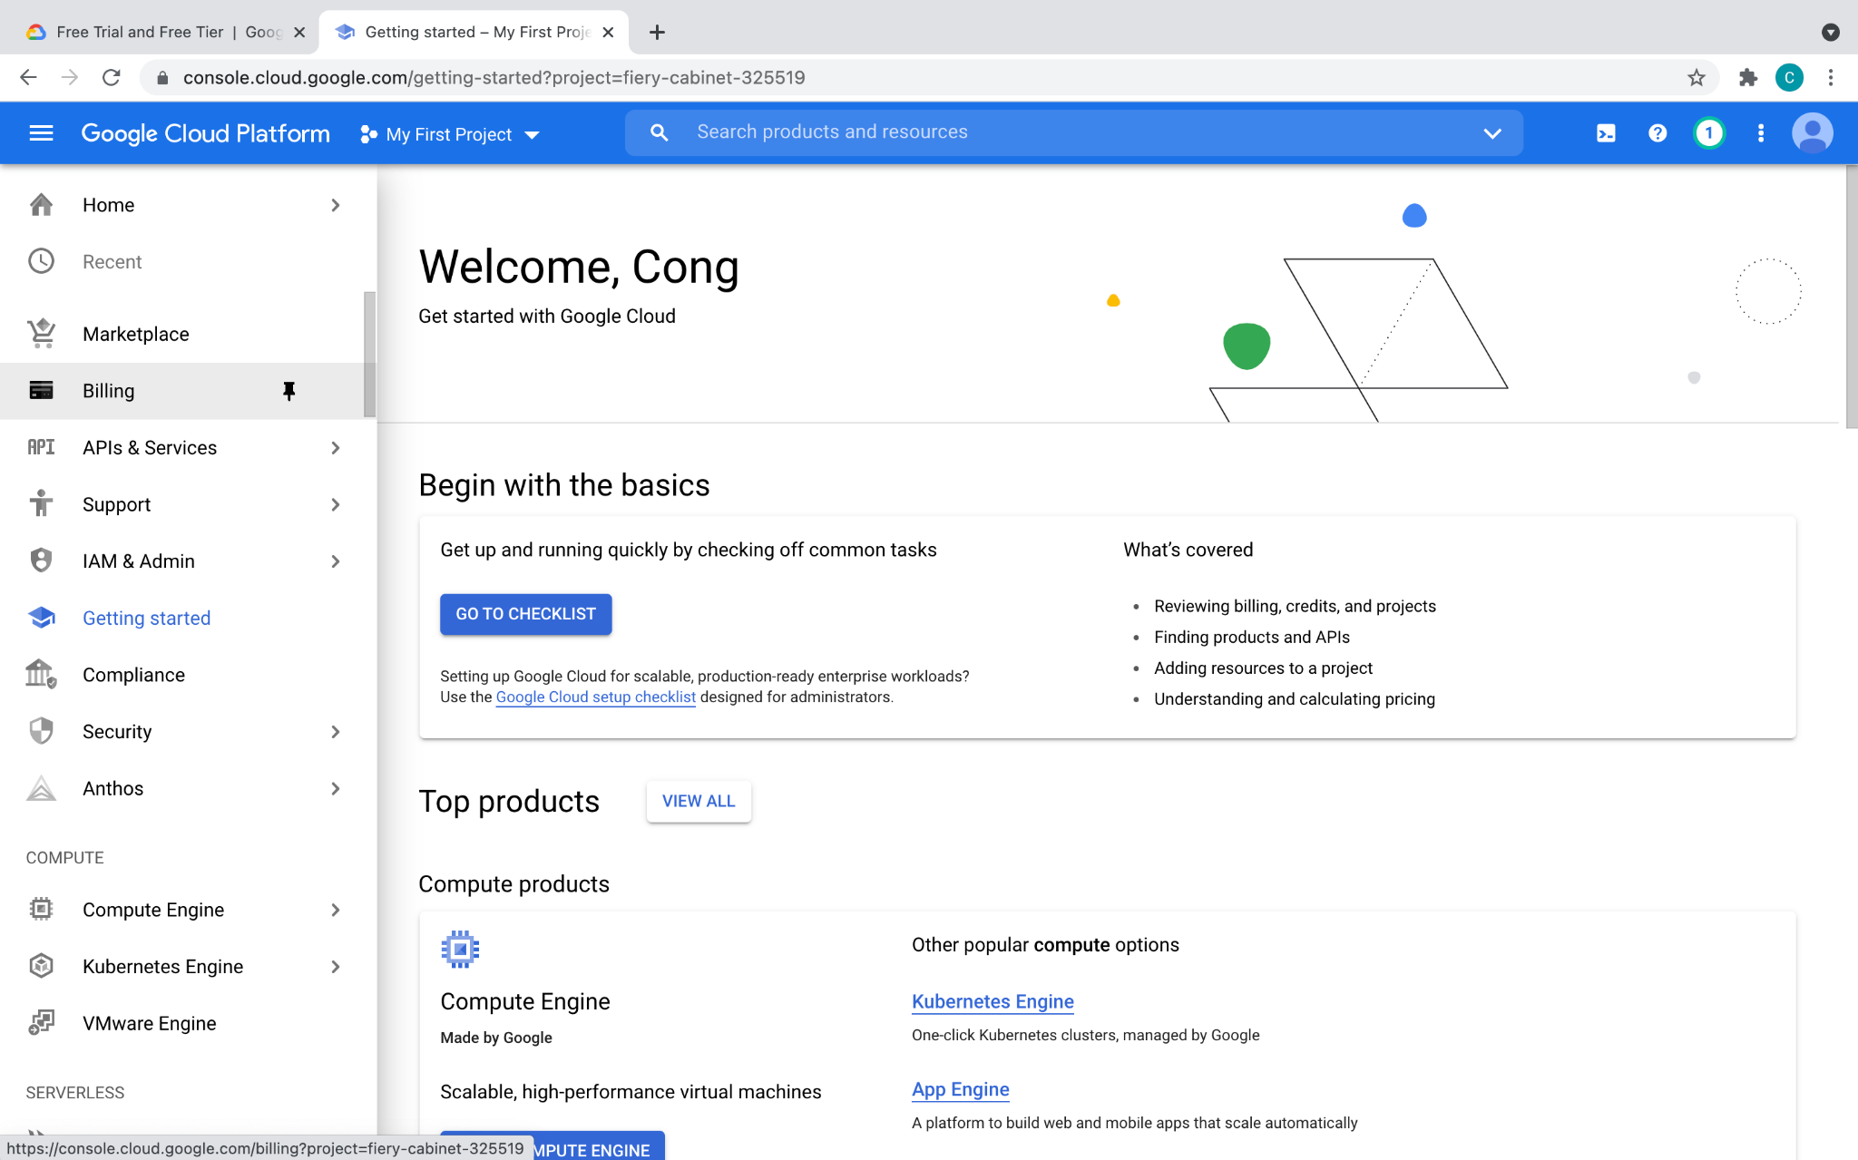

Slide 12
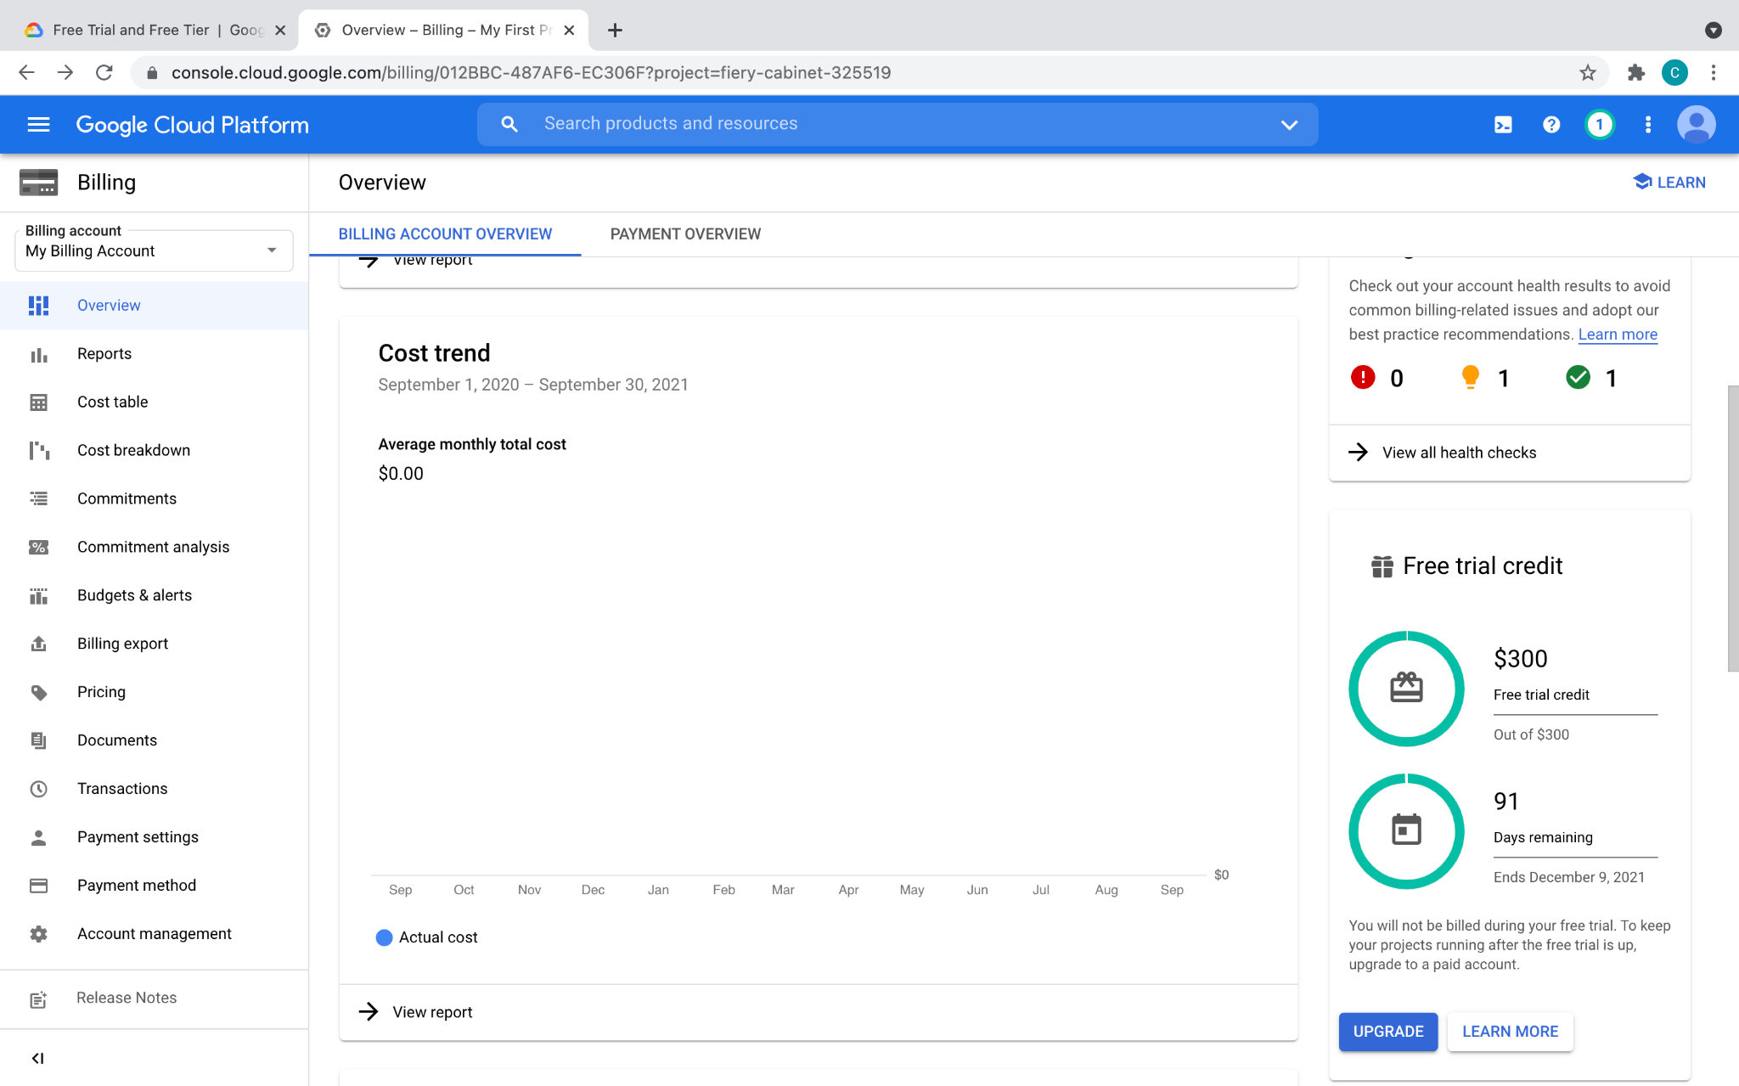

Slide 13
GCP: Create project
Project: basic unit for creating, enabling, and using all GCP services
managing APIs, billing, permissions
adding and removing collaborators
Visit console dashboard or cloud resource manager
Click on “create project / new project” and complete the flow
Ensure billing is pointing to the $300 credit

Slide 14
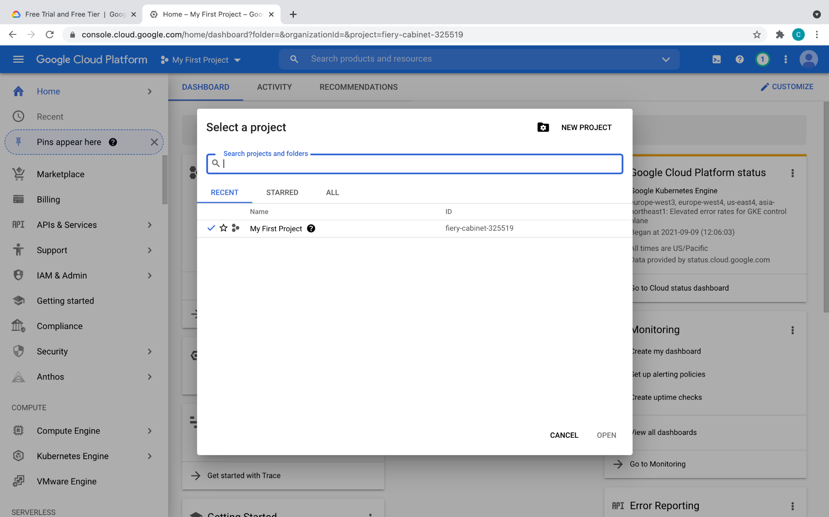


Slide 15
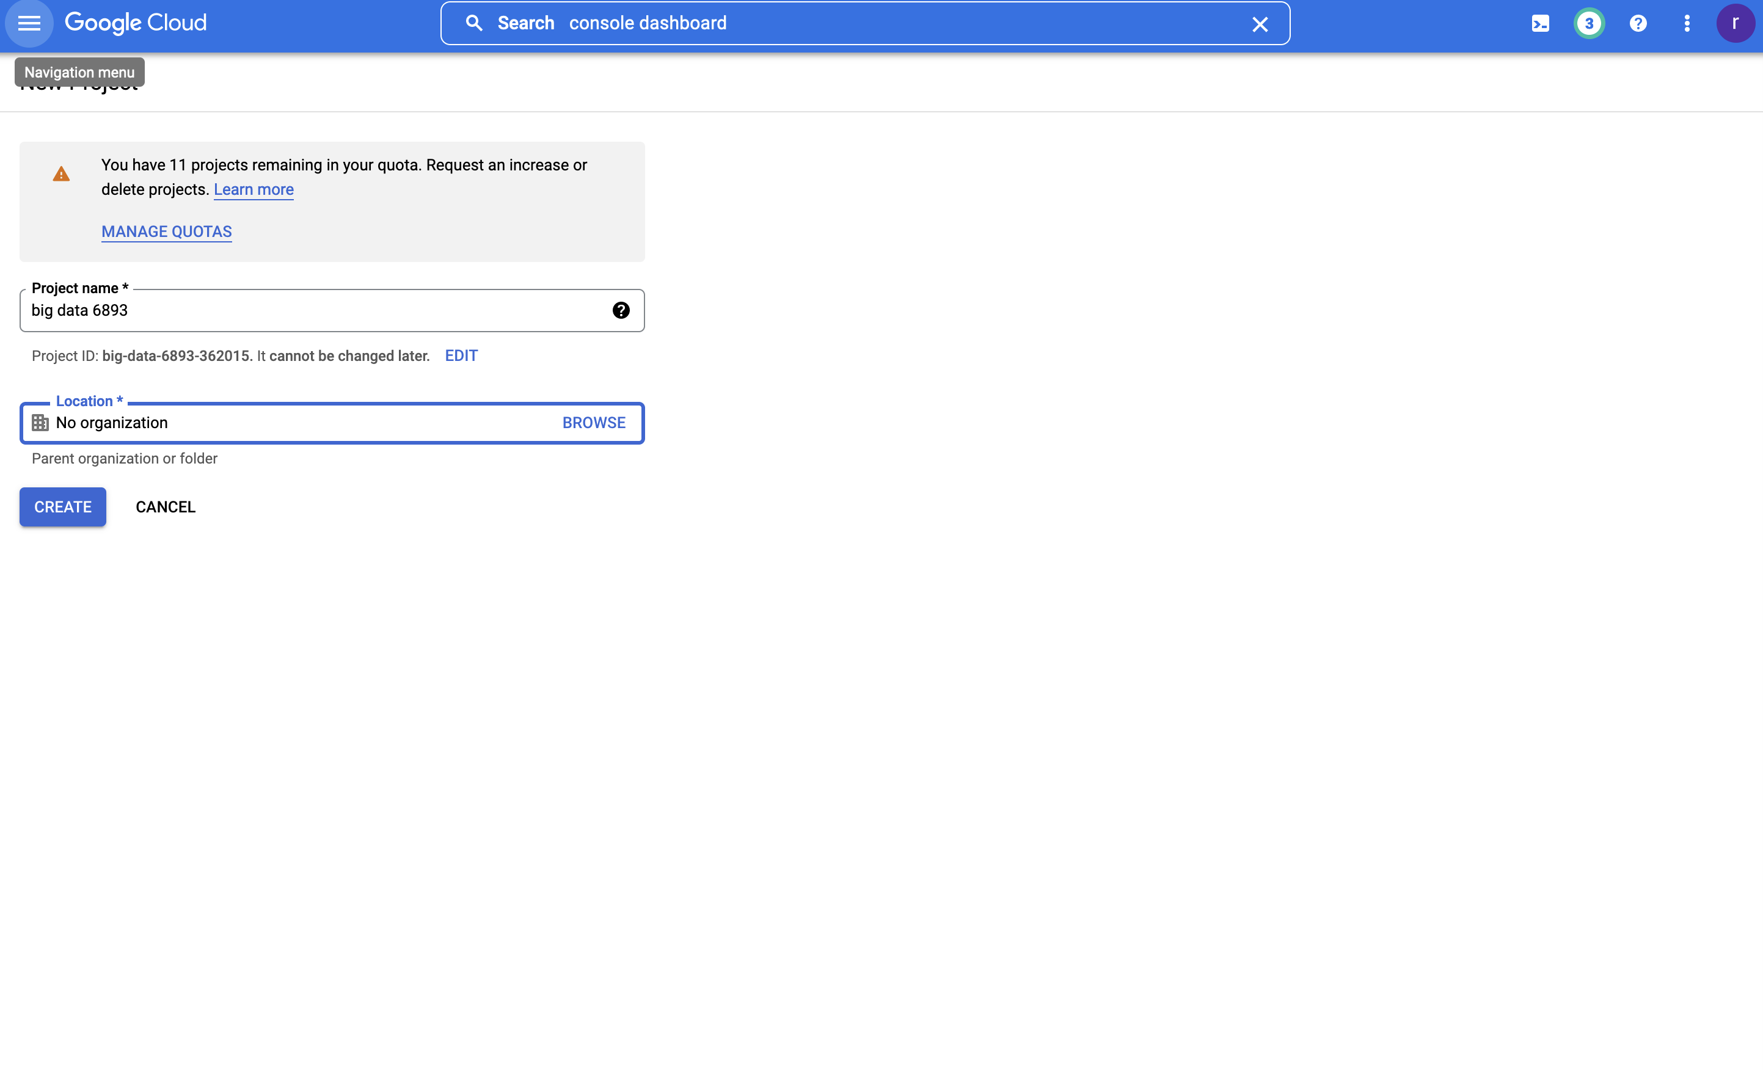
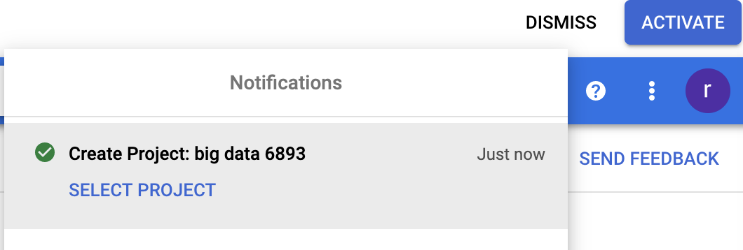


Slide 16
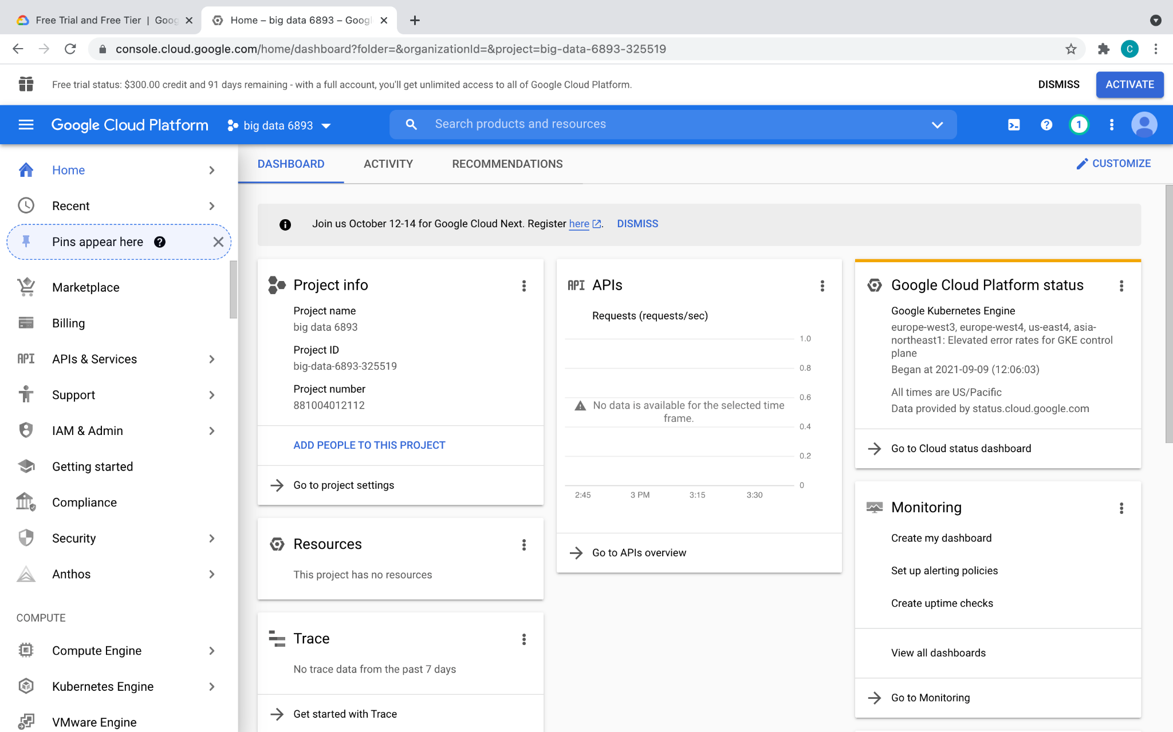

Slide 17
GCP: Interaction
Graphical UI / console: Useful to create VMs, set up clusters, provision resources, manage teams, etc
Command line tools / Cloud SDK: Useful for interacting from local host and using the resources once provisioned. E.x. ssh into instances, submit jobs, copy files, etc
Cloud Shell: Same as command line, but web-based and pre-installed with SDK and tools

Slide 18
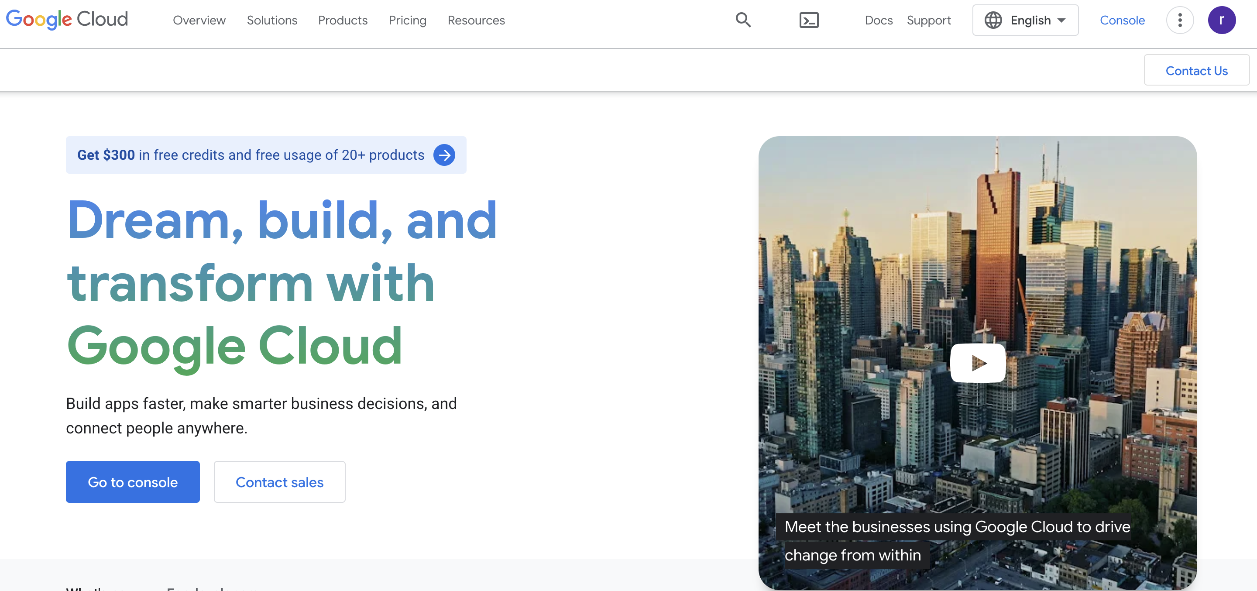

Search in Google: GCP console

Slide 19
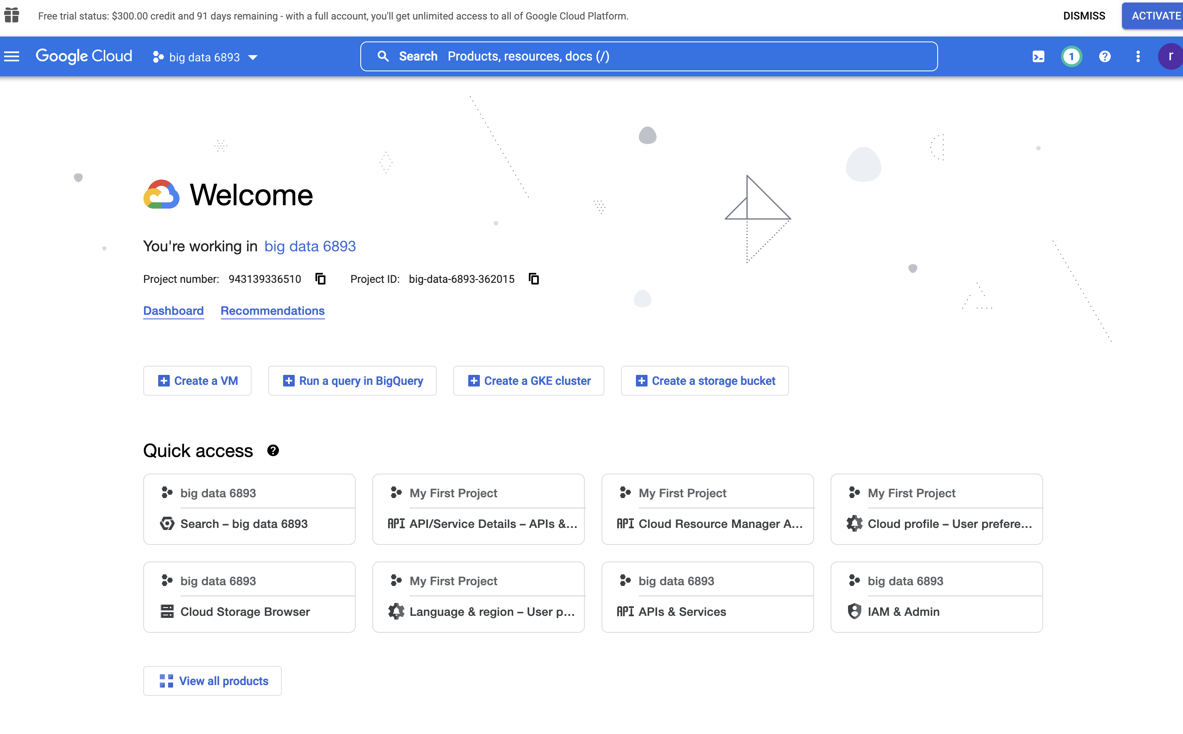


Slide 20
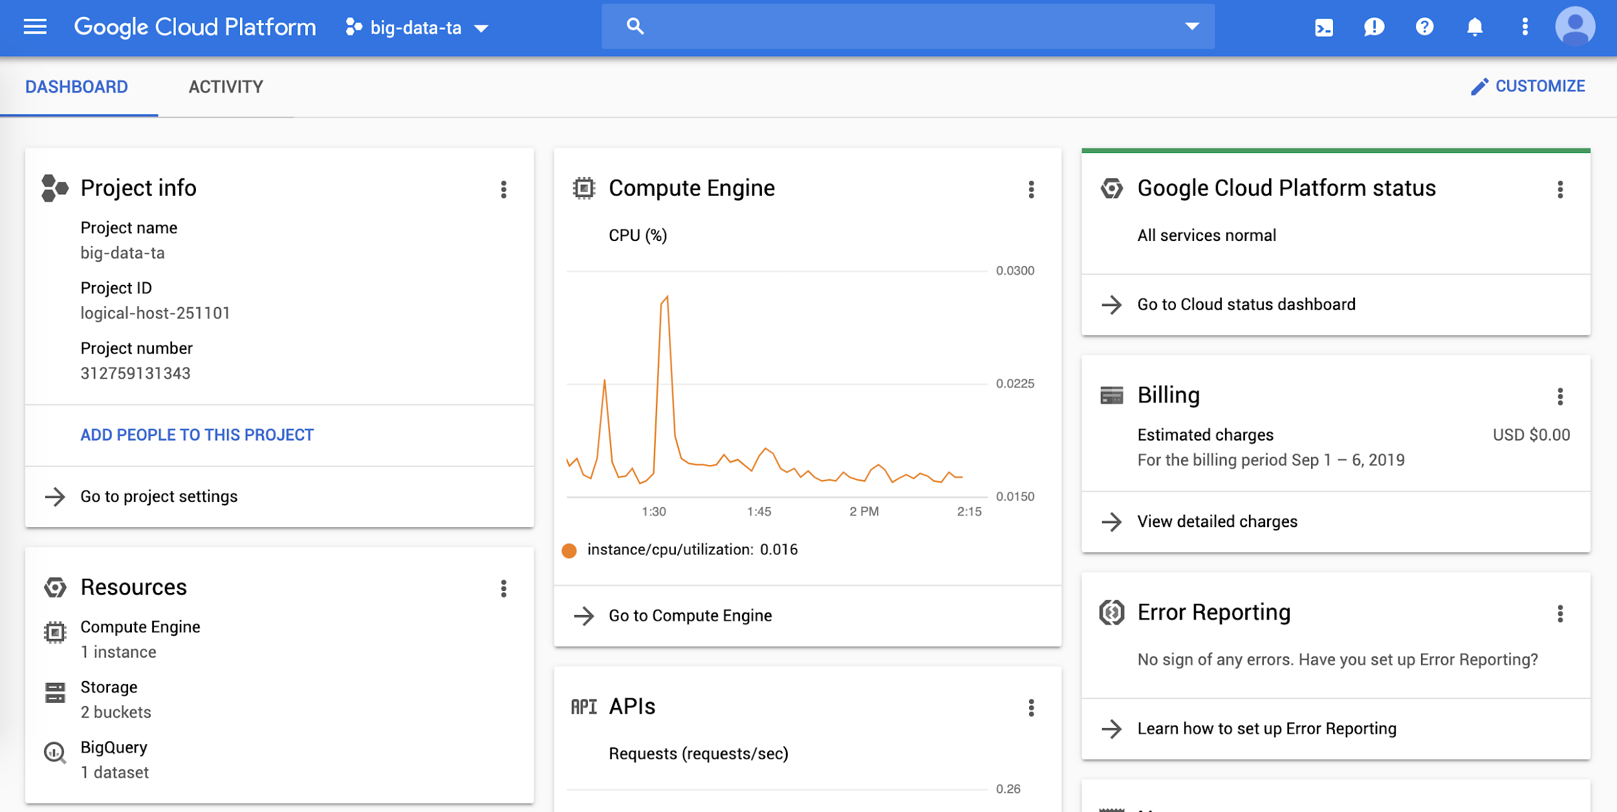
GCP: console
Search for services here
Manage / Enable APIs

Slide 21
GCP: Cloud SDK
Install the SDK that is suitable for your local environment: https://cloud.google.com/sdk/docs/quickstarts
Some testing after installation:
gcloud info
gcloud auth list
gcloud components list
Change default config:
gcloud init

Slide 22
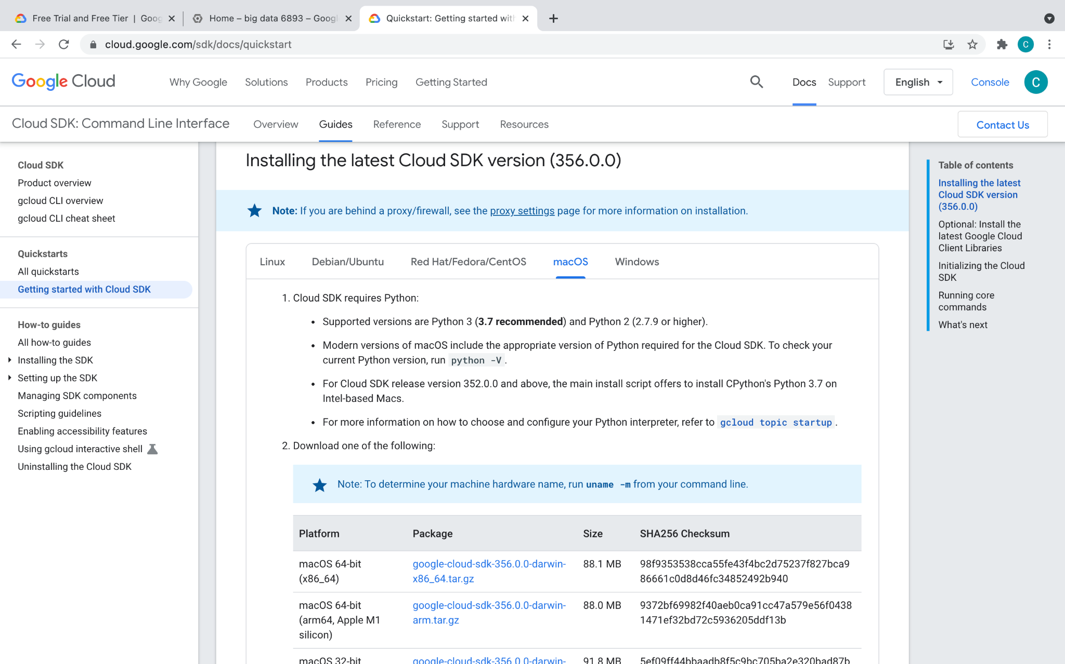

Slide 23
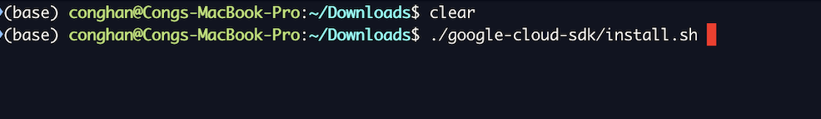
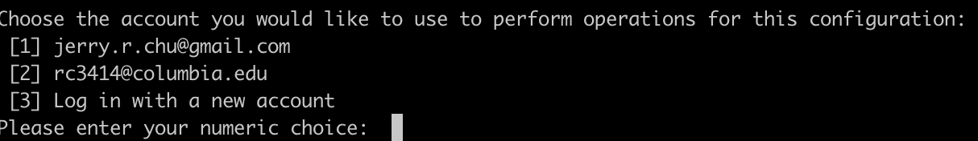
Follow the instruction on the website. If you have a previous account, please select
the correct account and project

Slide 24
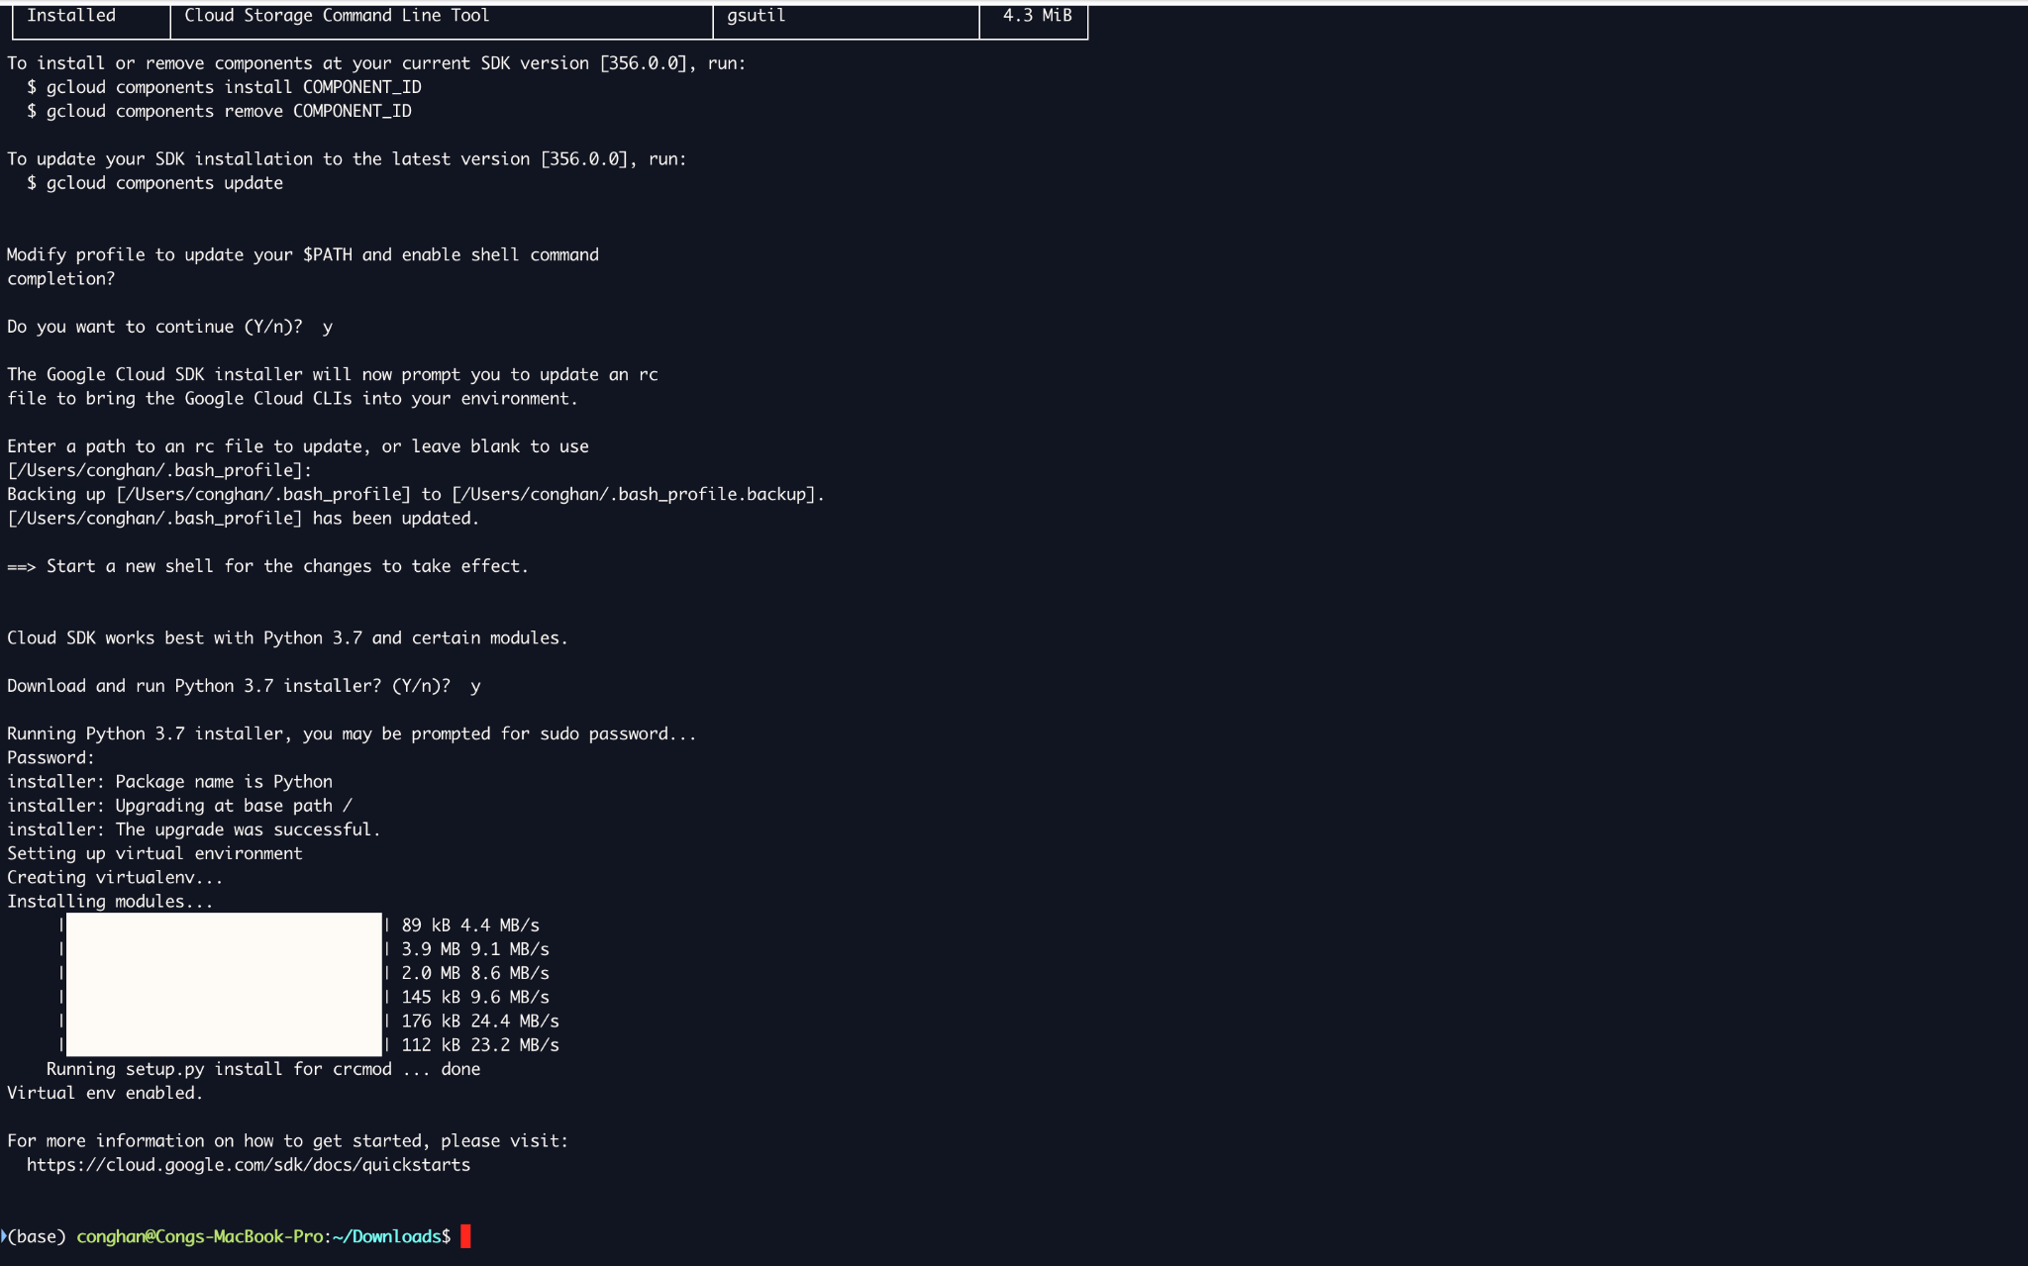

Slide 25
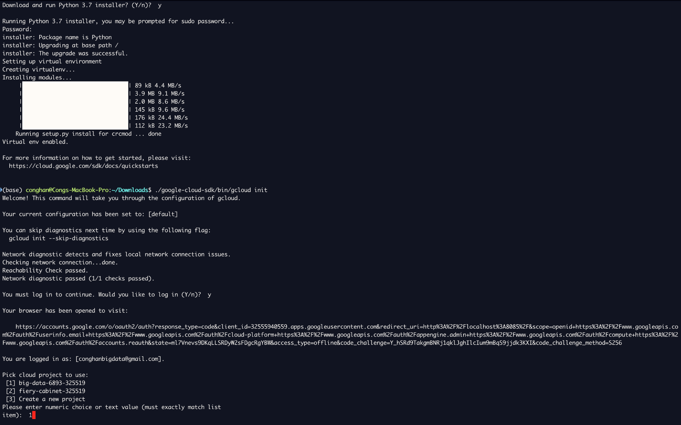

Slide 26
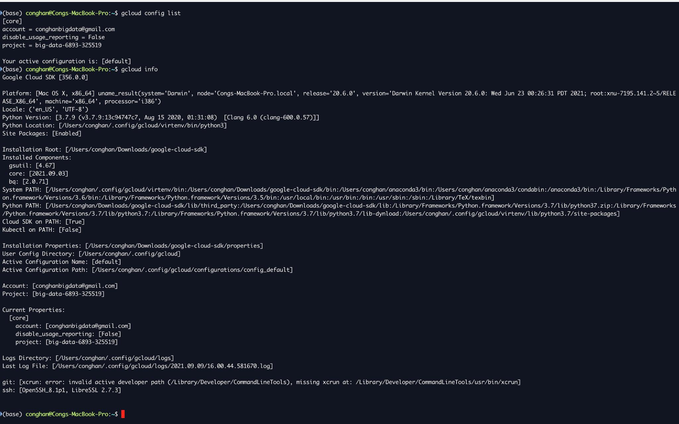

Slide 27
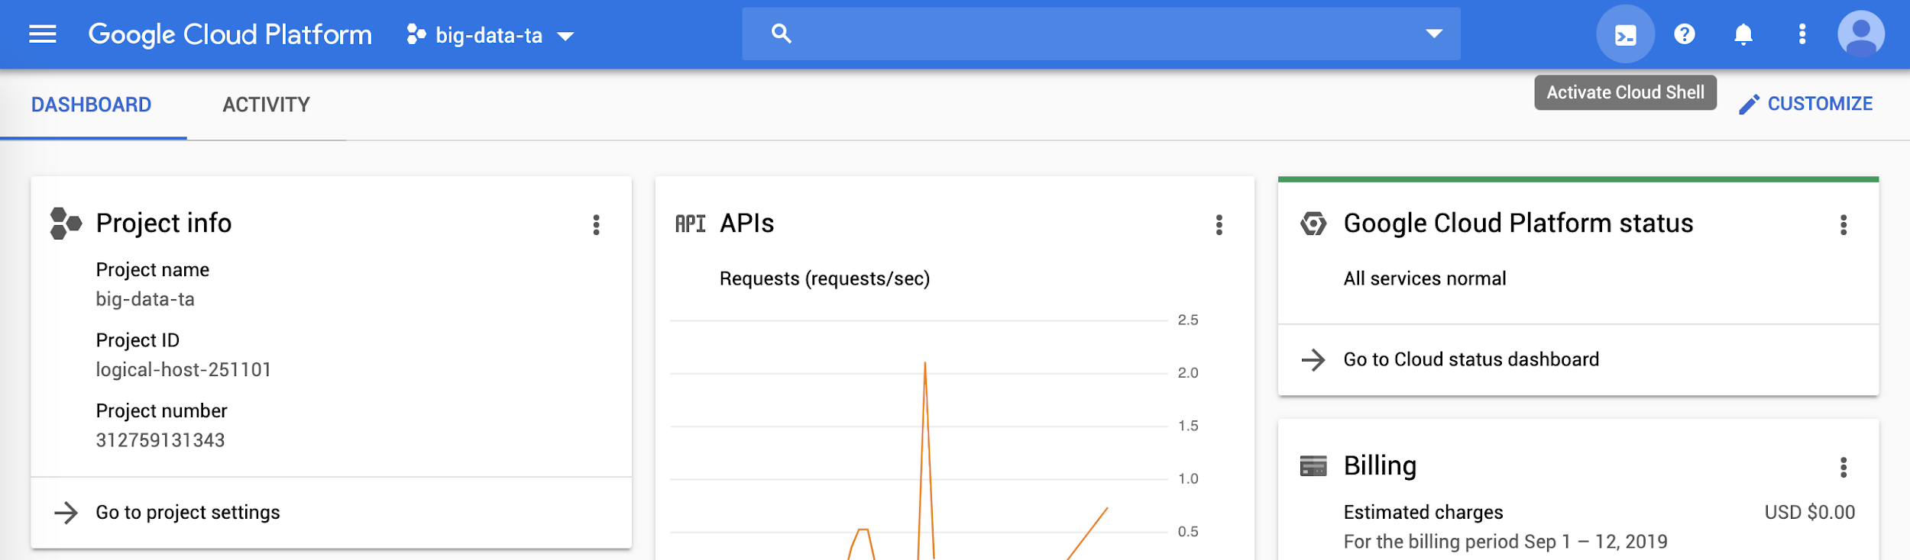
GCP: Cloud Shell
persistent home directory :). The most useful way to complete the HW0

Slide 28
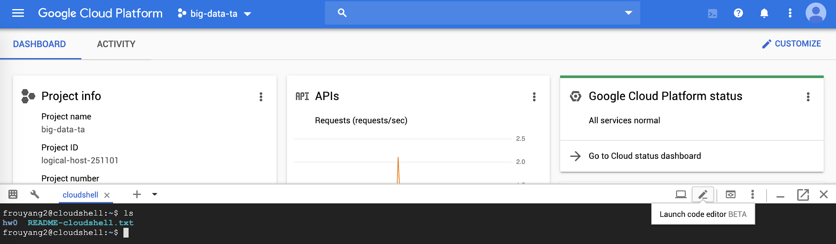


GCP: Cloud Shell
Files can be uploaded through Clound Storage, which will be introduced later

Slide 29
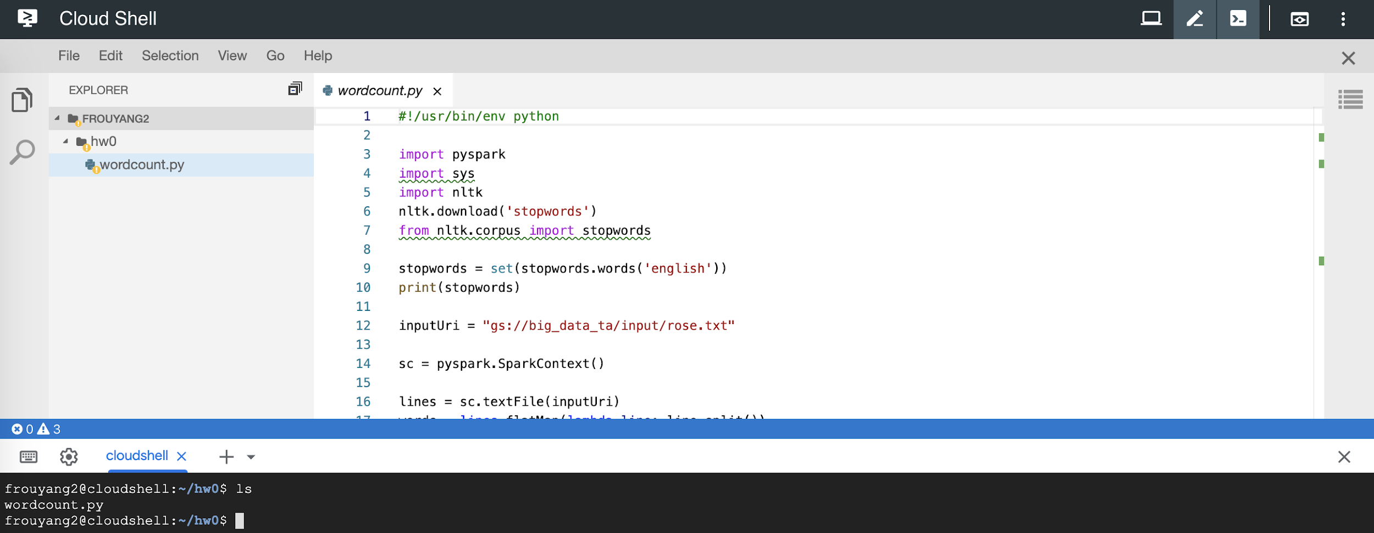
GCP: Cloud Shell Code Editor

Slide 30
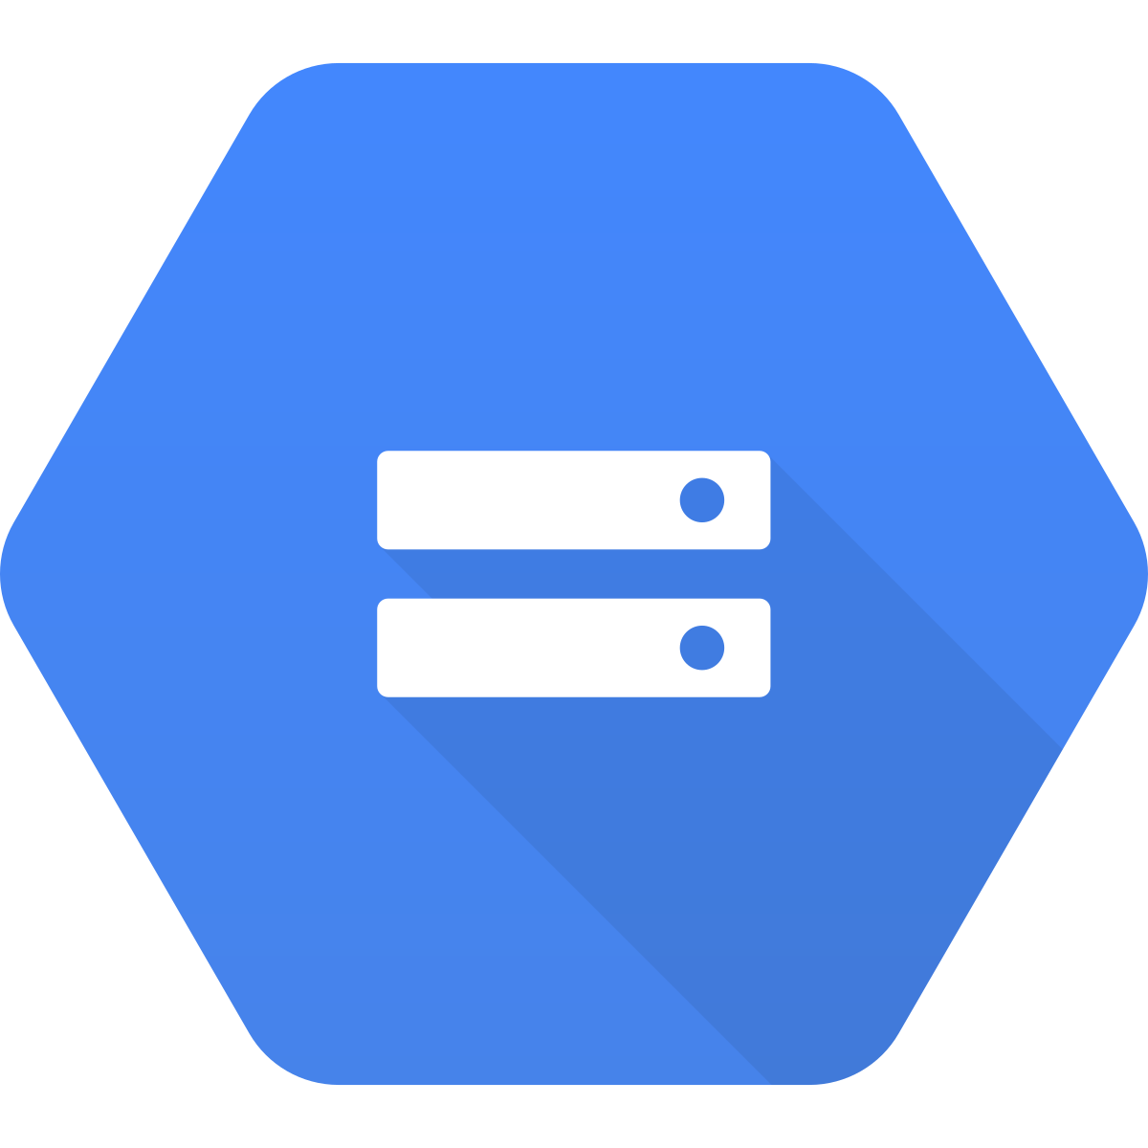
Cloud Storage

Slide 31
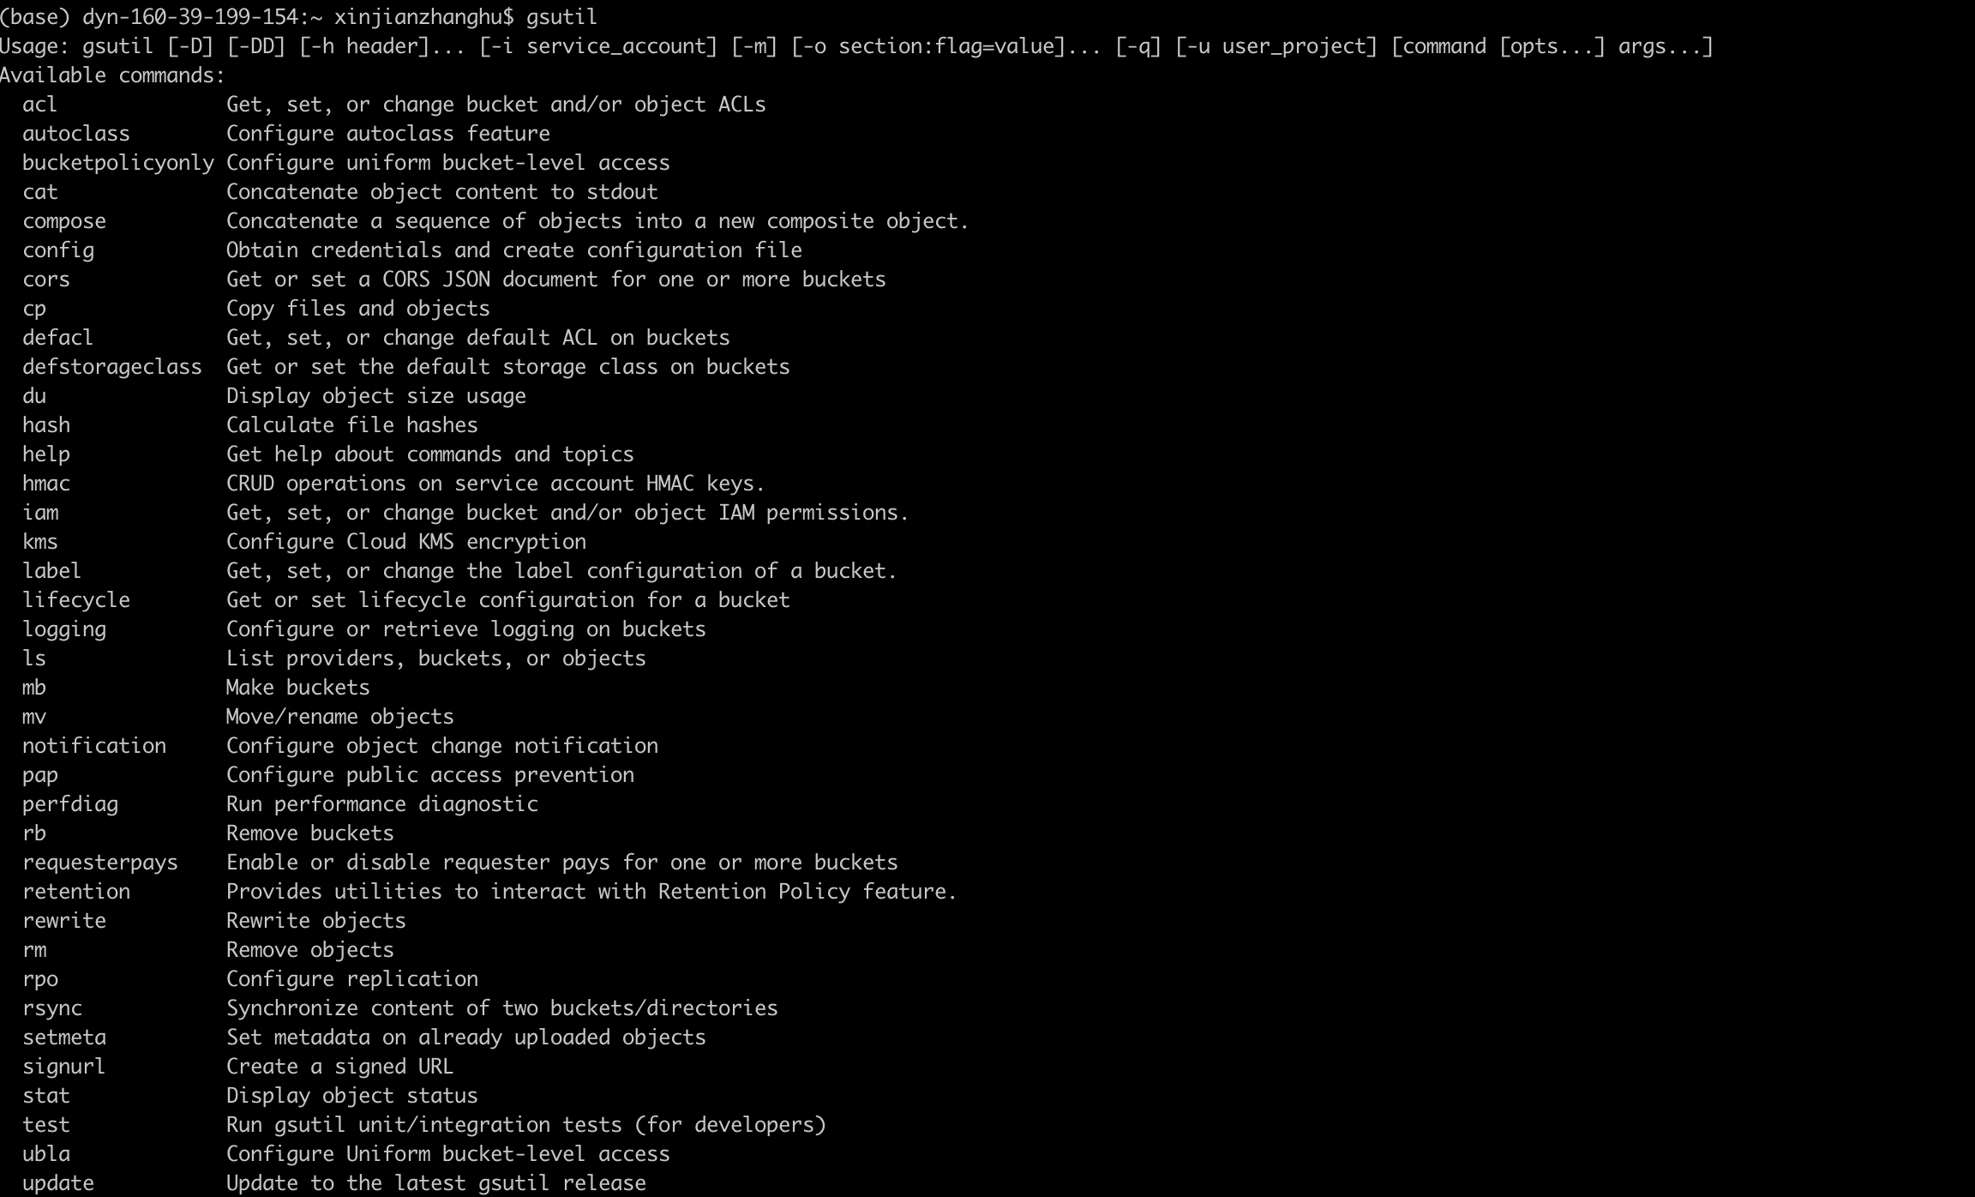
Cloud Storage
Online file storage system
Graphical UI through console
Command line tool: gsutil

Slide 32
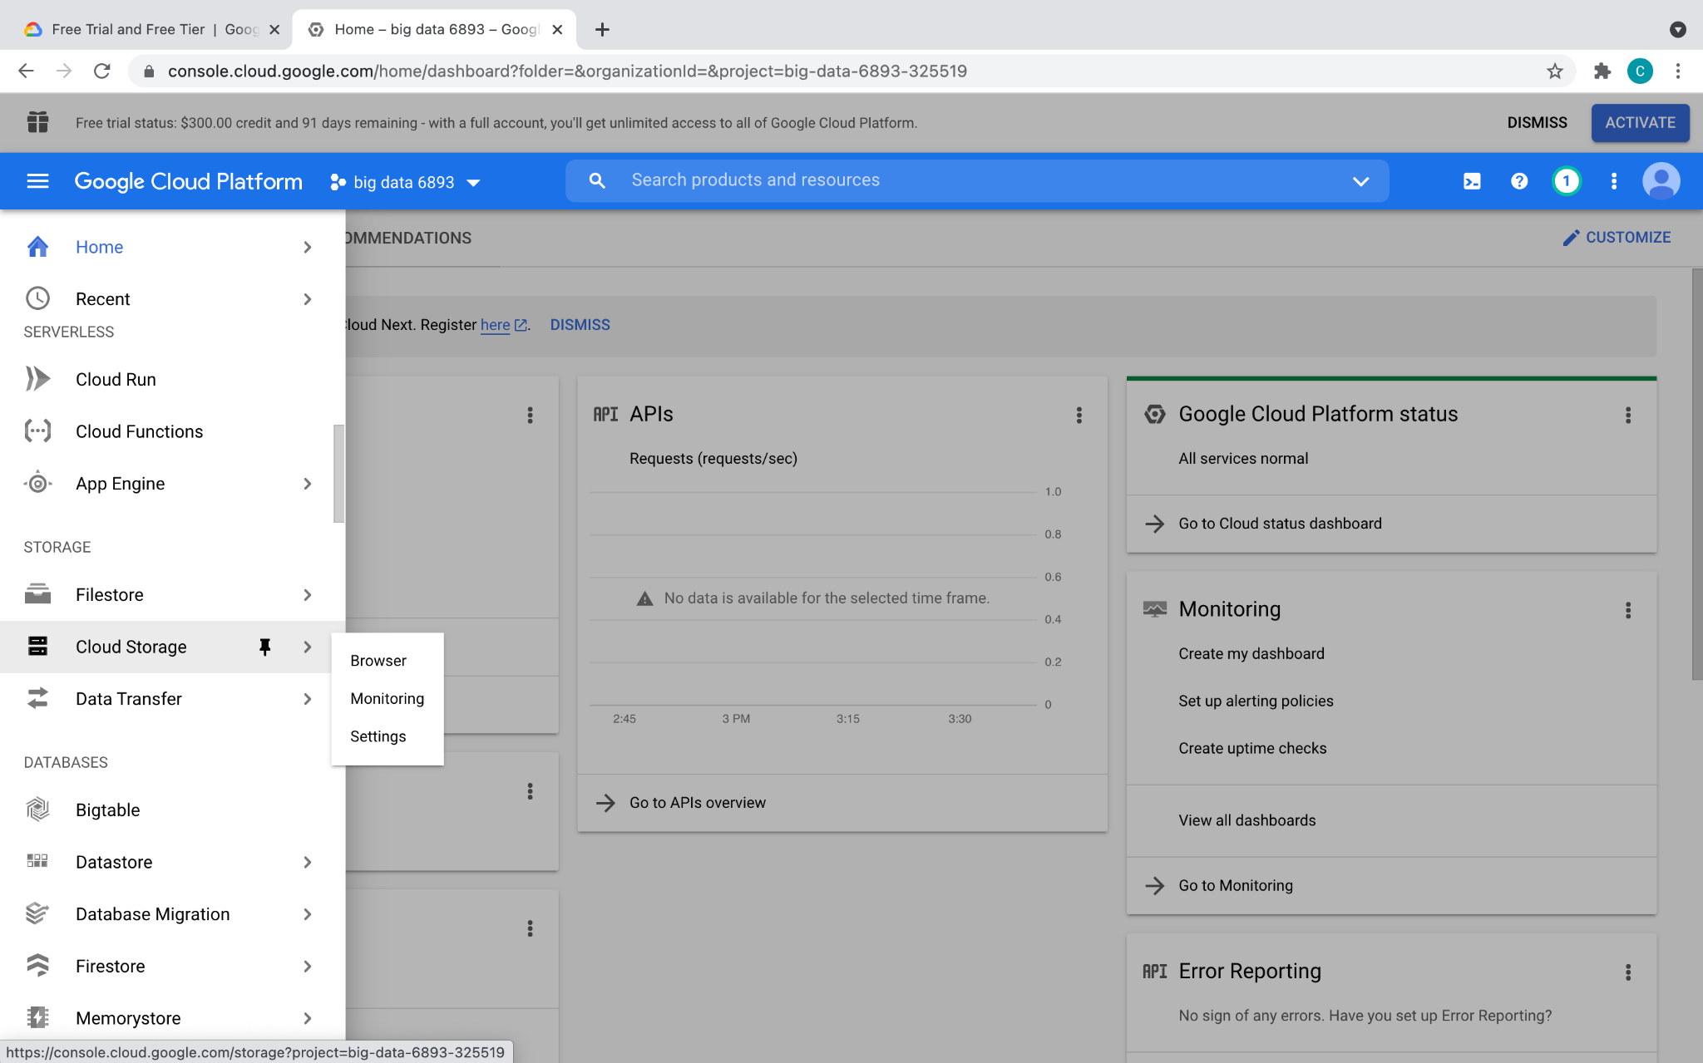
Cloud Storage

Slide 33
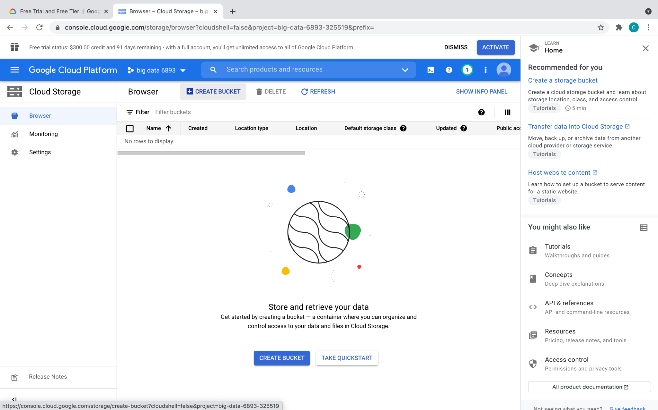
Cloud Storage

Slide 34
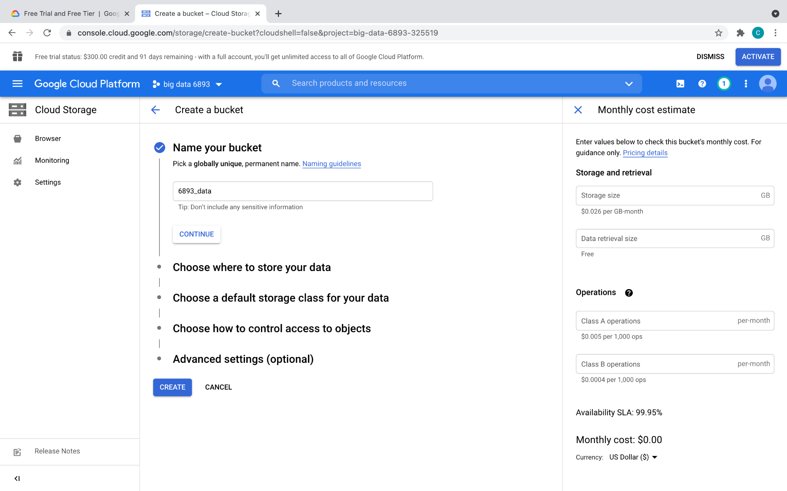
Cloud Storage
Name your own bucket

Slide 35
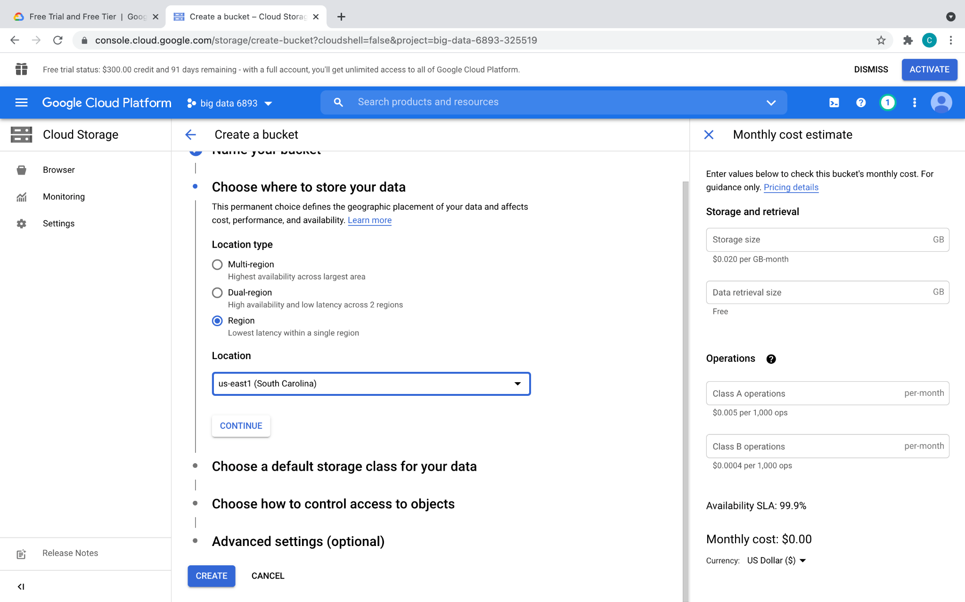
Cloud Storage

Slide 36
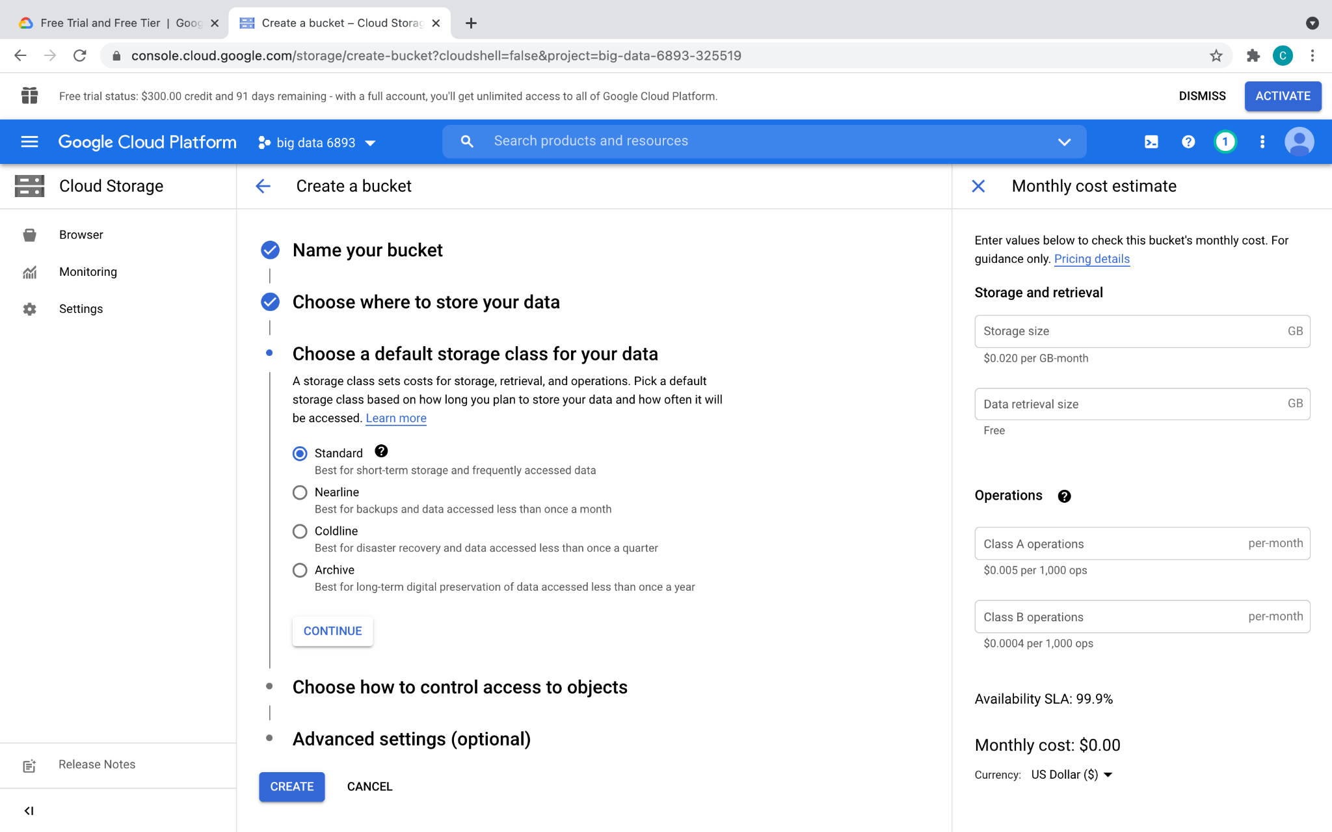
Cloud Storage

Slide 37
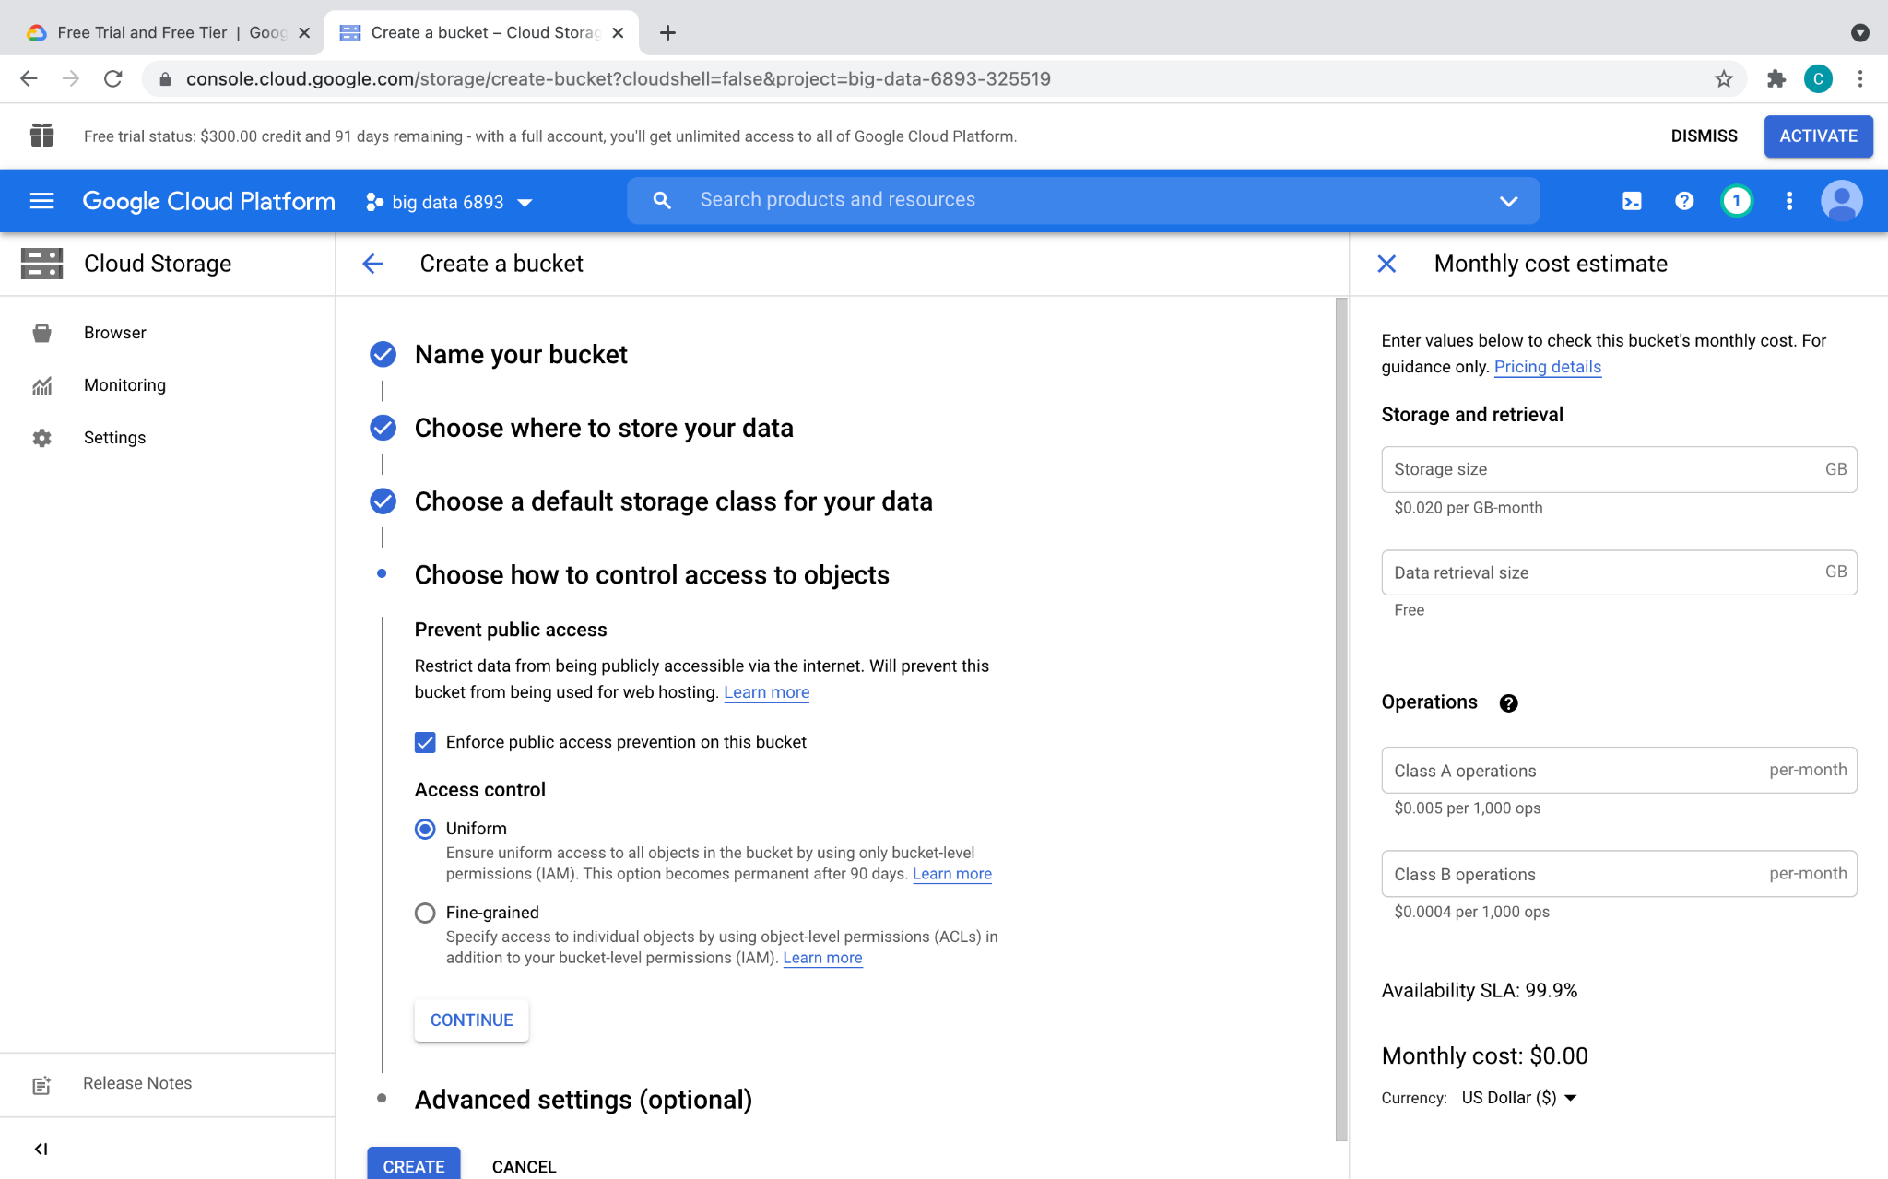
Cloud Storage

Slide 38
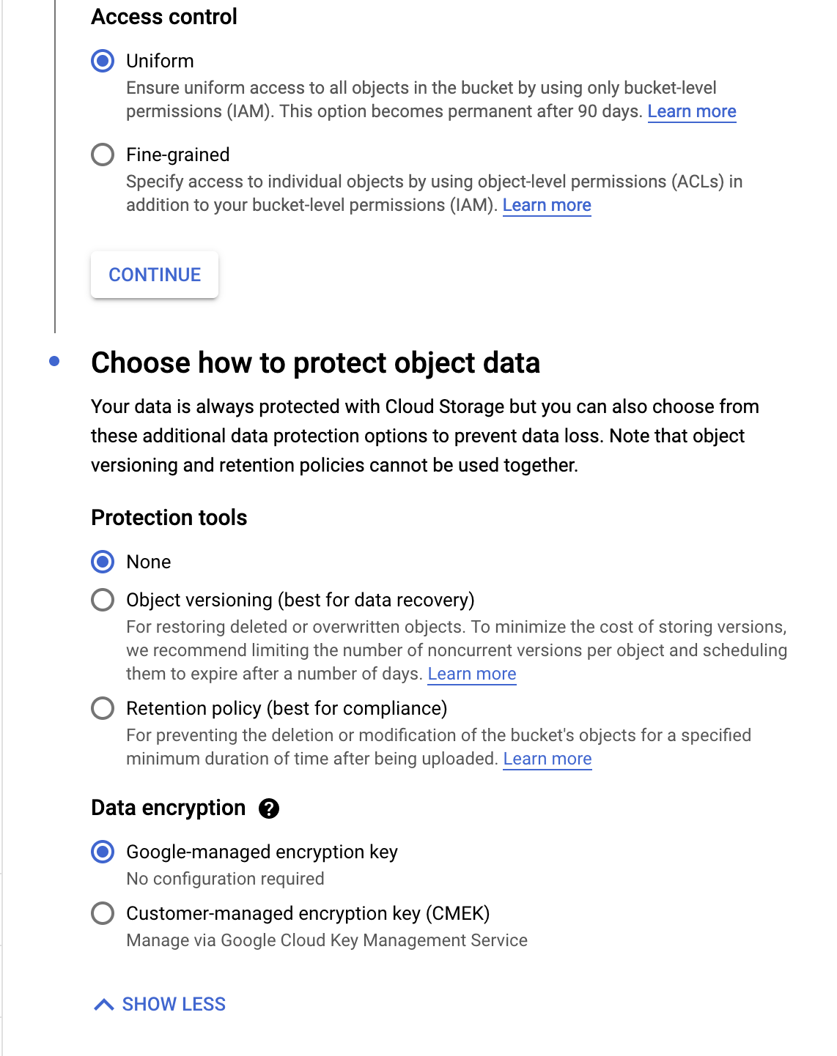
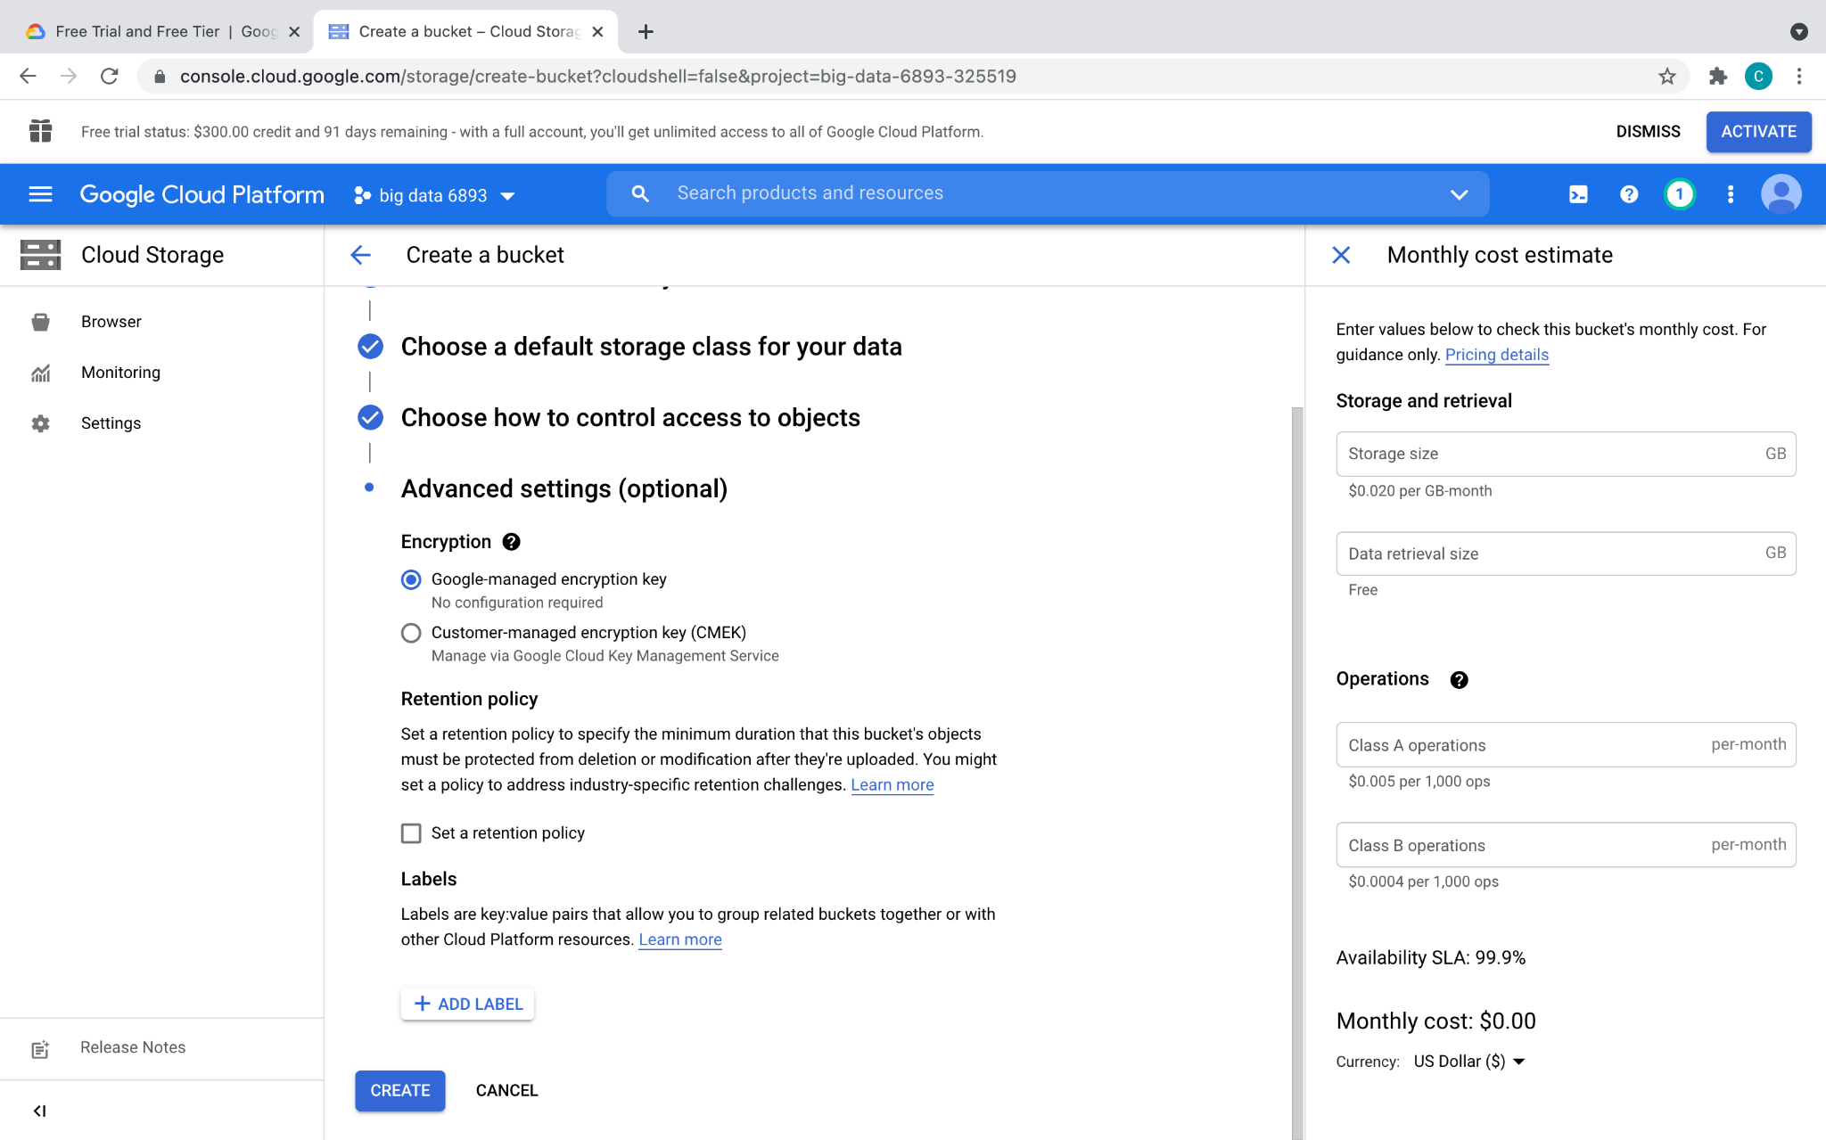
Cloud Storage

Slide 39
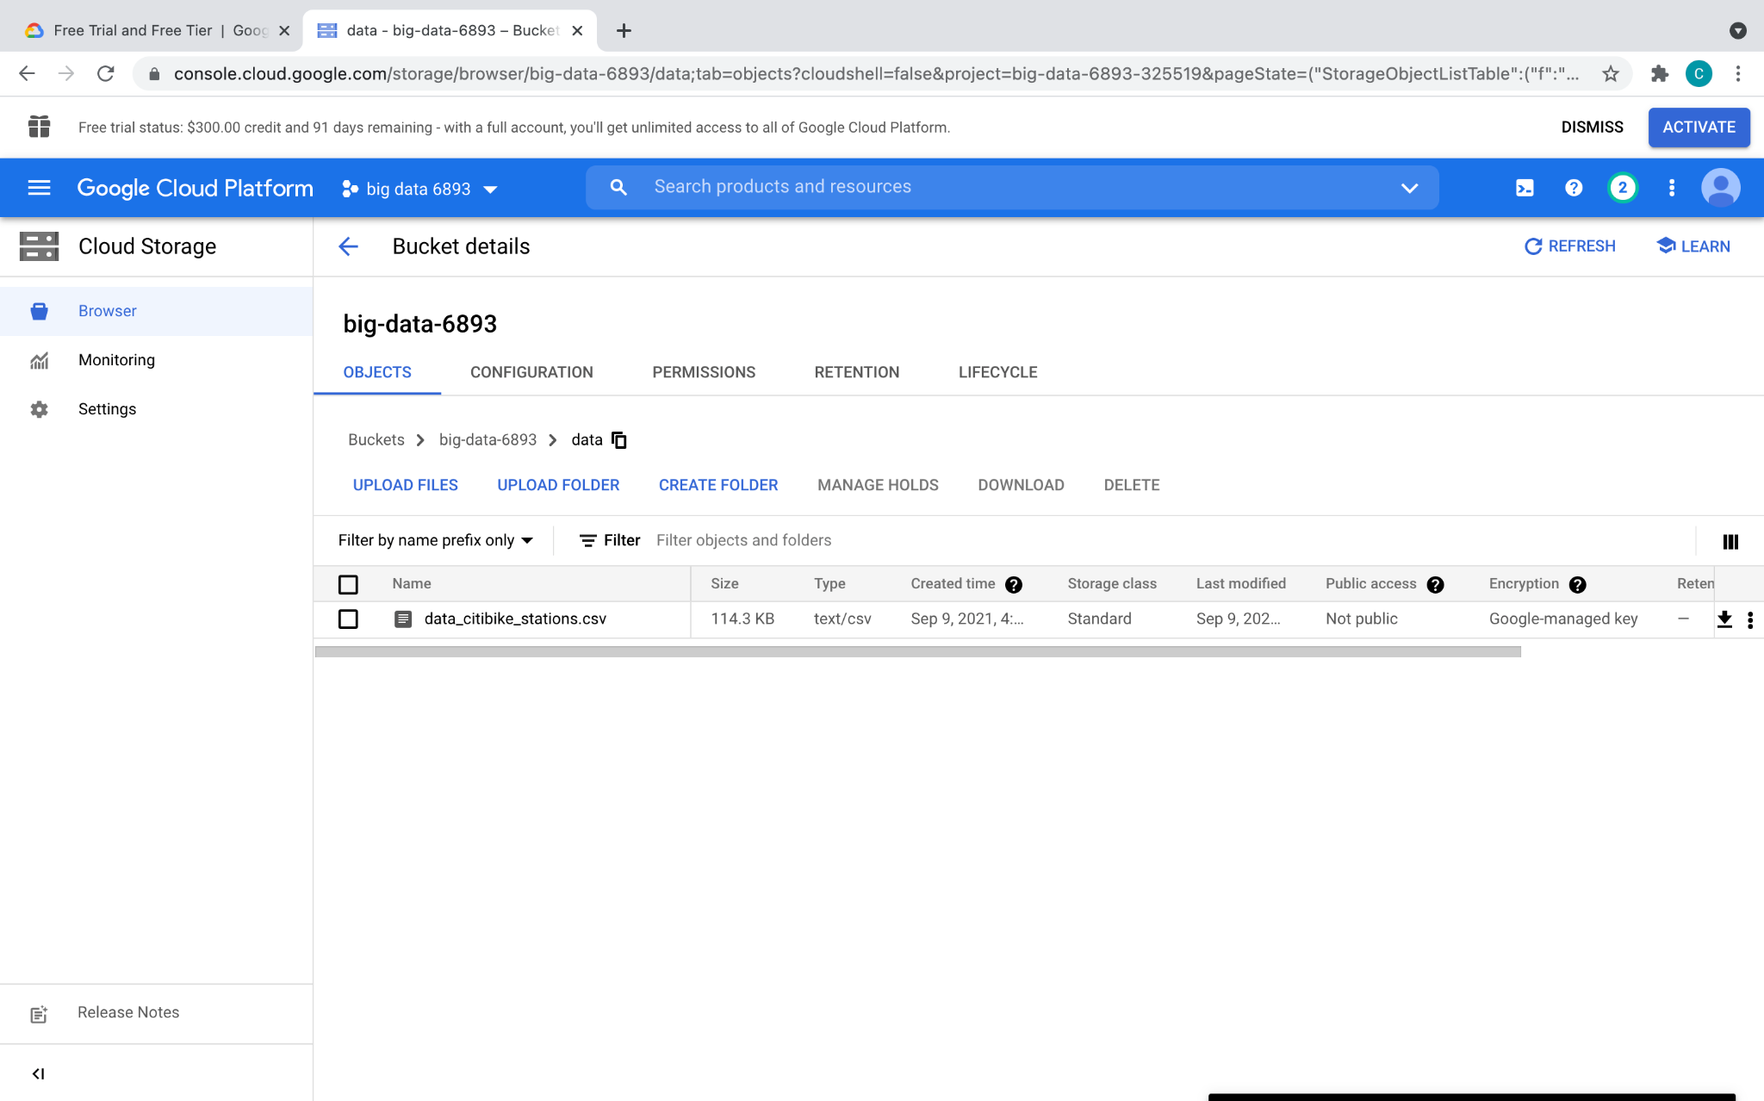
Cloud Storage
dataset provided in HW0 details
Cllick on the uploaded dataset file

Slide 40
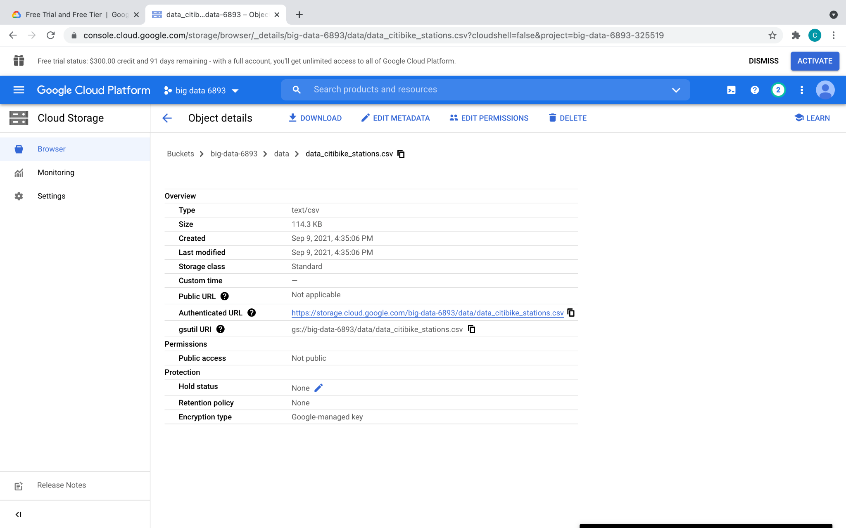
Cloud Storage
Uniform Resource Identifier, like a filepath on GCP, use this in your program

Slide 41
Cloud Storage - gsutil
Interact with Cloud Storage through command line
Works similar to unix command line
Useful commands:
Concatenate object content to stdout: gsutil cat [-h] url…
Copy file: gsutil cp [OPTION]... src_url dst_url
List files: gsutil ls [OPTION]... url…
Explore more at https://cloud.google.com/storage/docs/gsutil

Slide 42

BigQuery

Slide 43
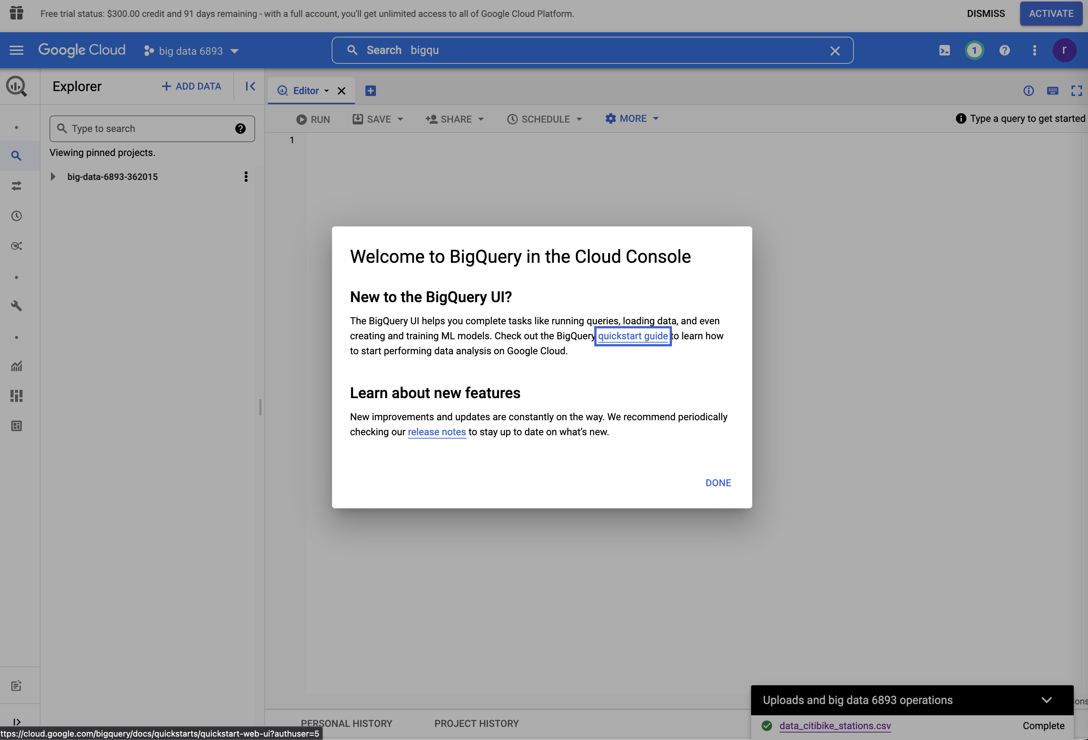
BigQuery
Data warehouse for analytics
SQL-like languages to interact with DB
RESTful APIs / client libraries for programmatic access
Graphical UI
search for BigQuery and go for it

Slide 44
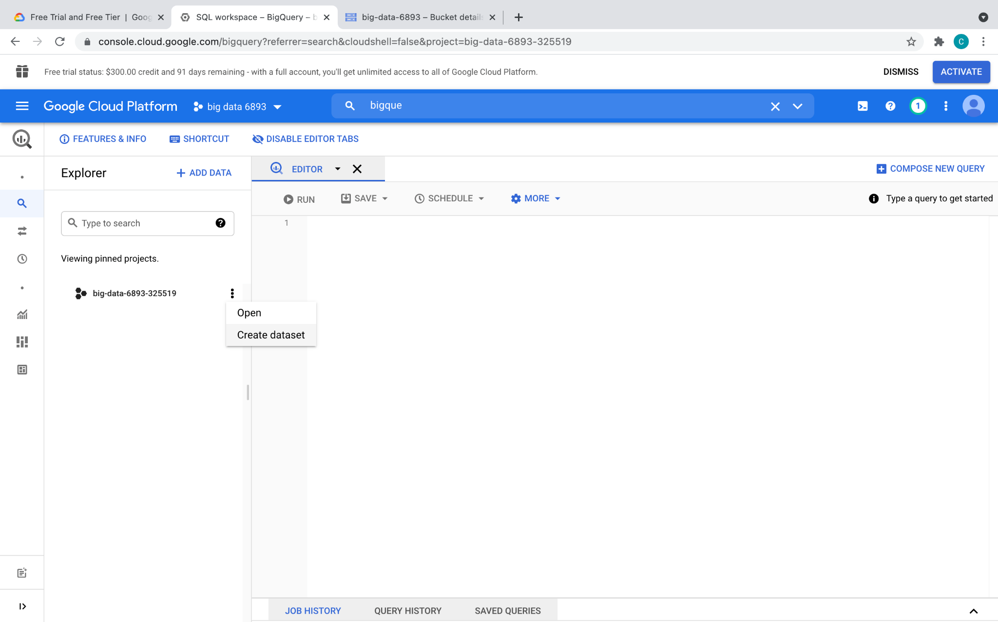
BigQuery

Slide 45
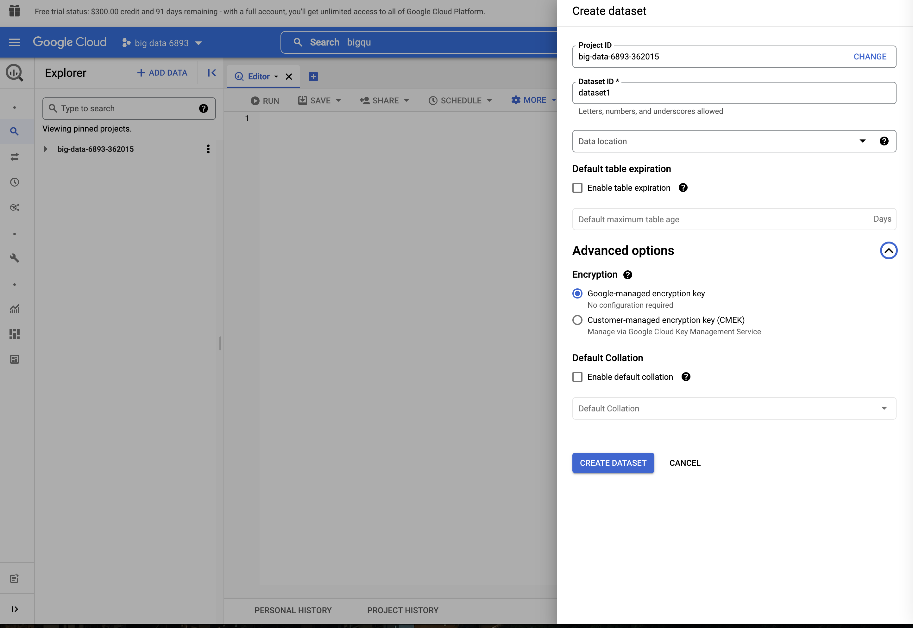
BigQuery

Slide 46
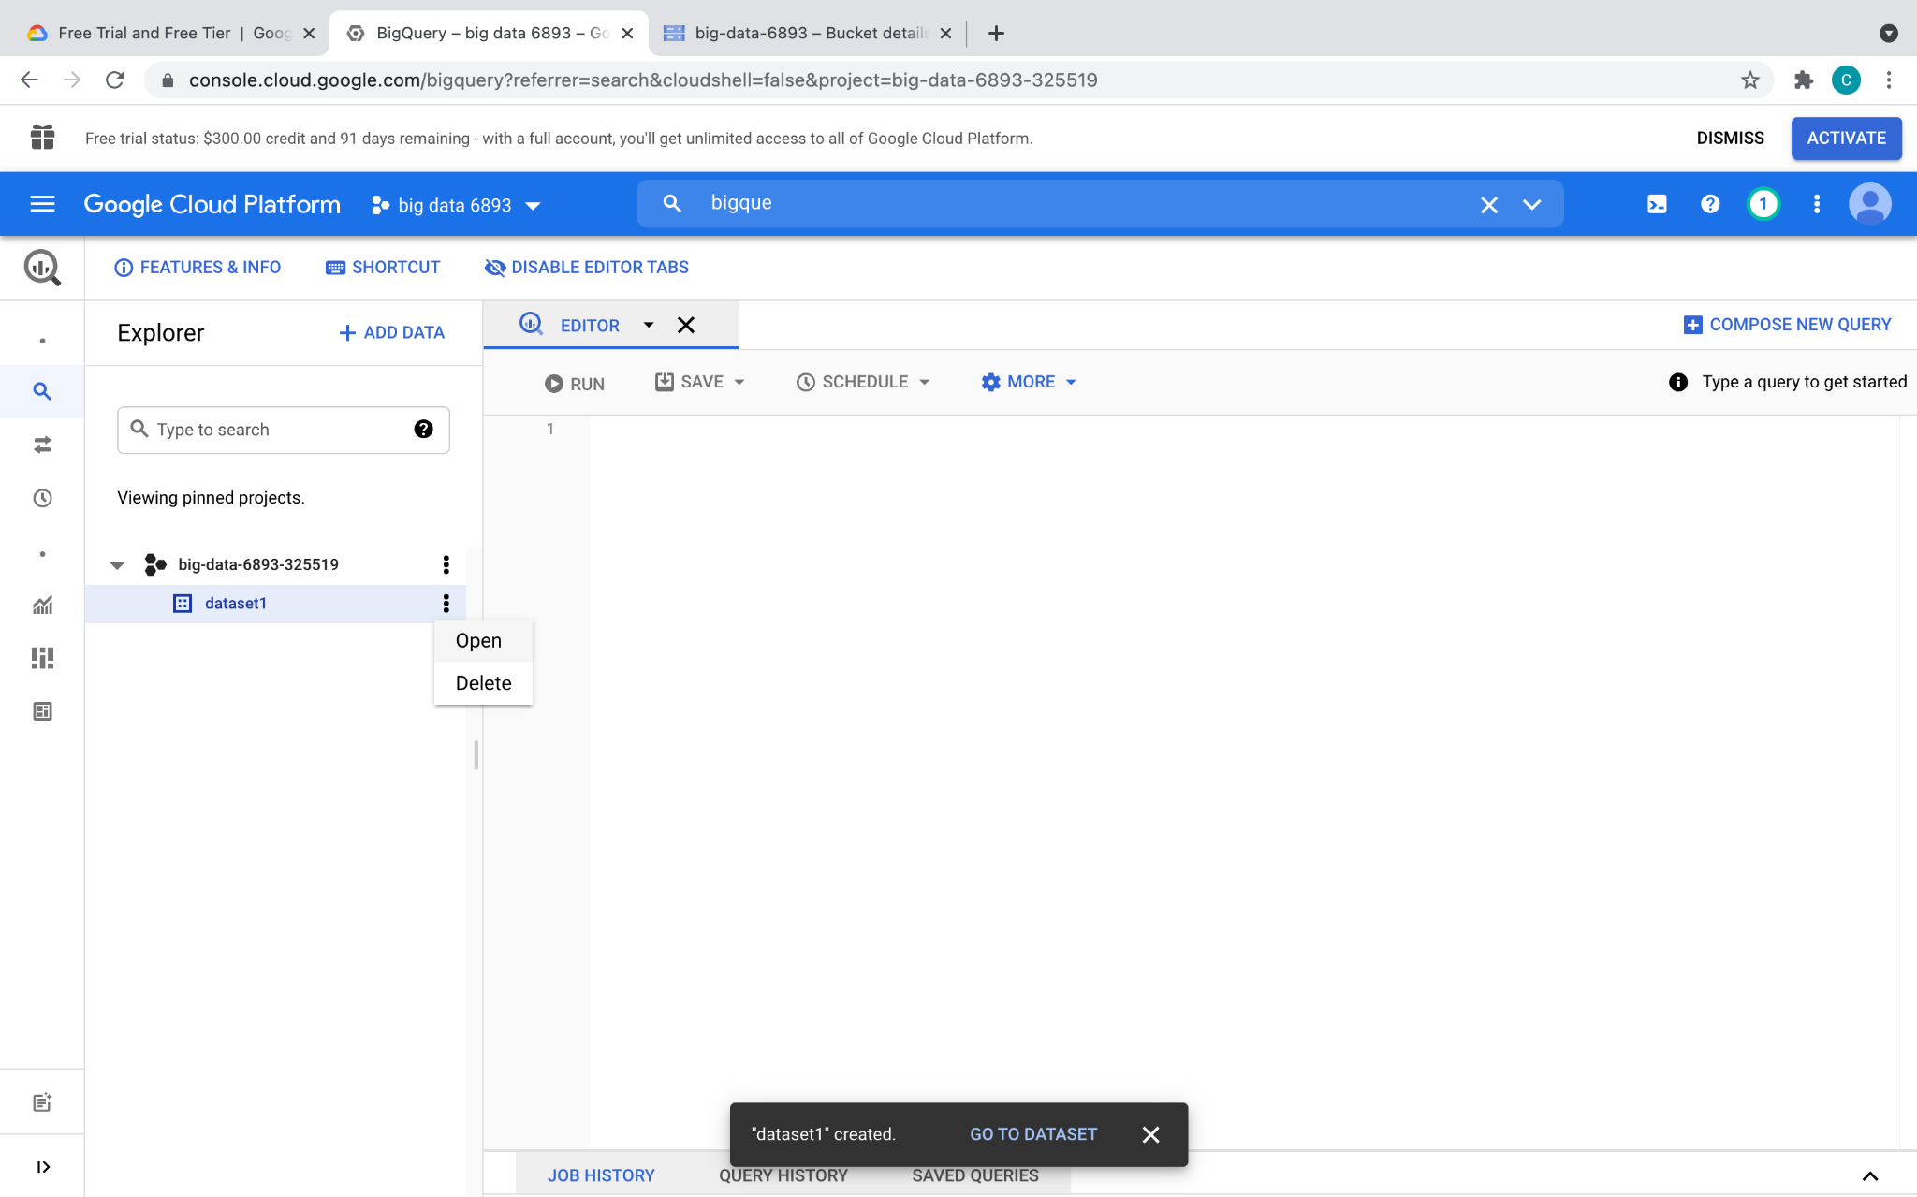
BigQuery

Slide 47
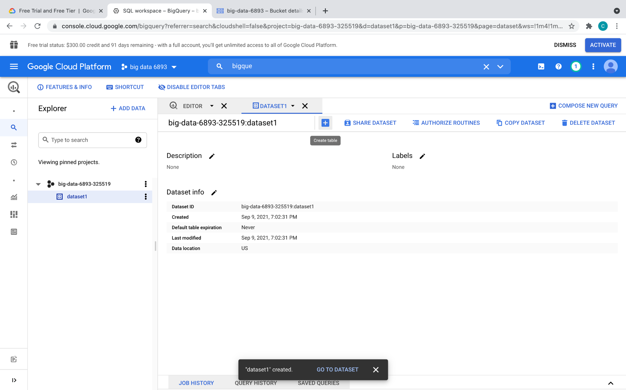
BigQuery

Slide 48
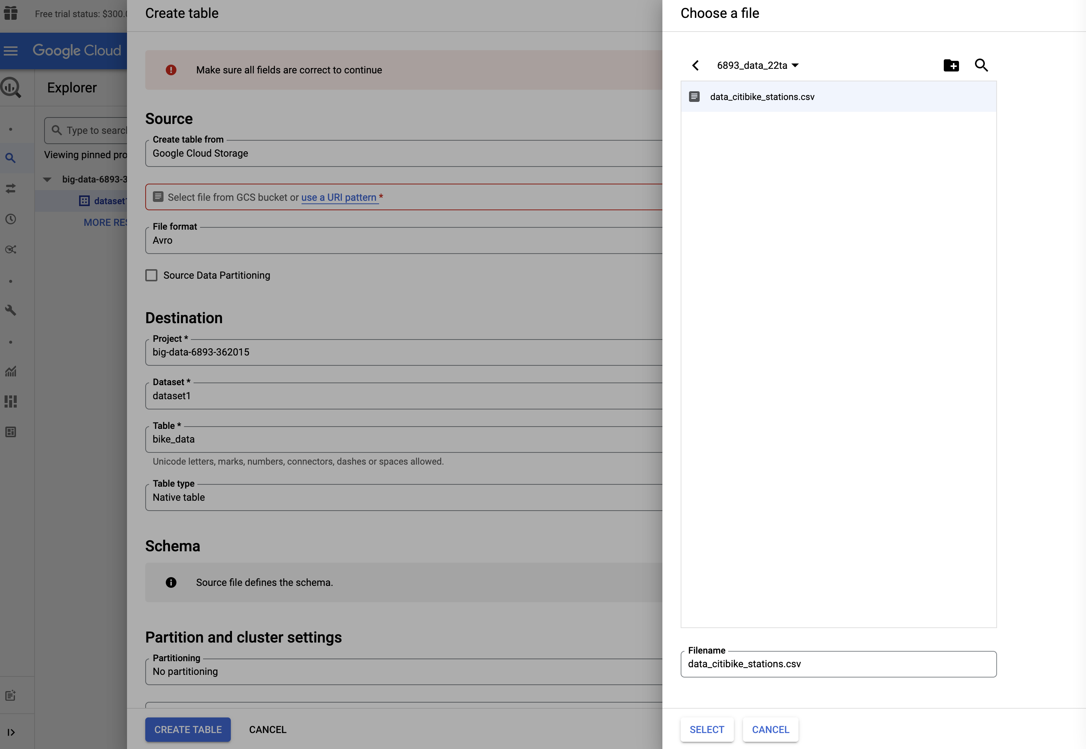
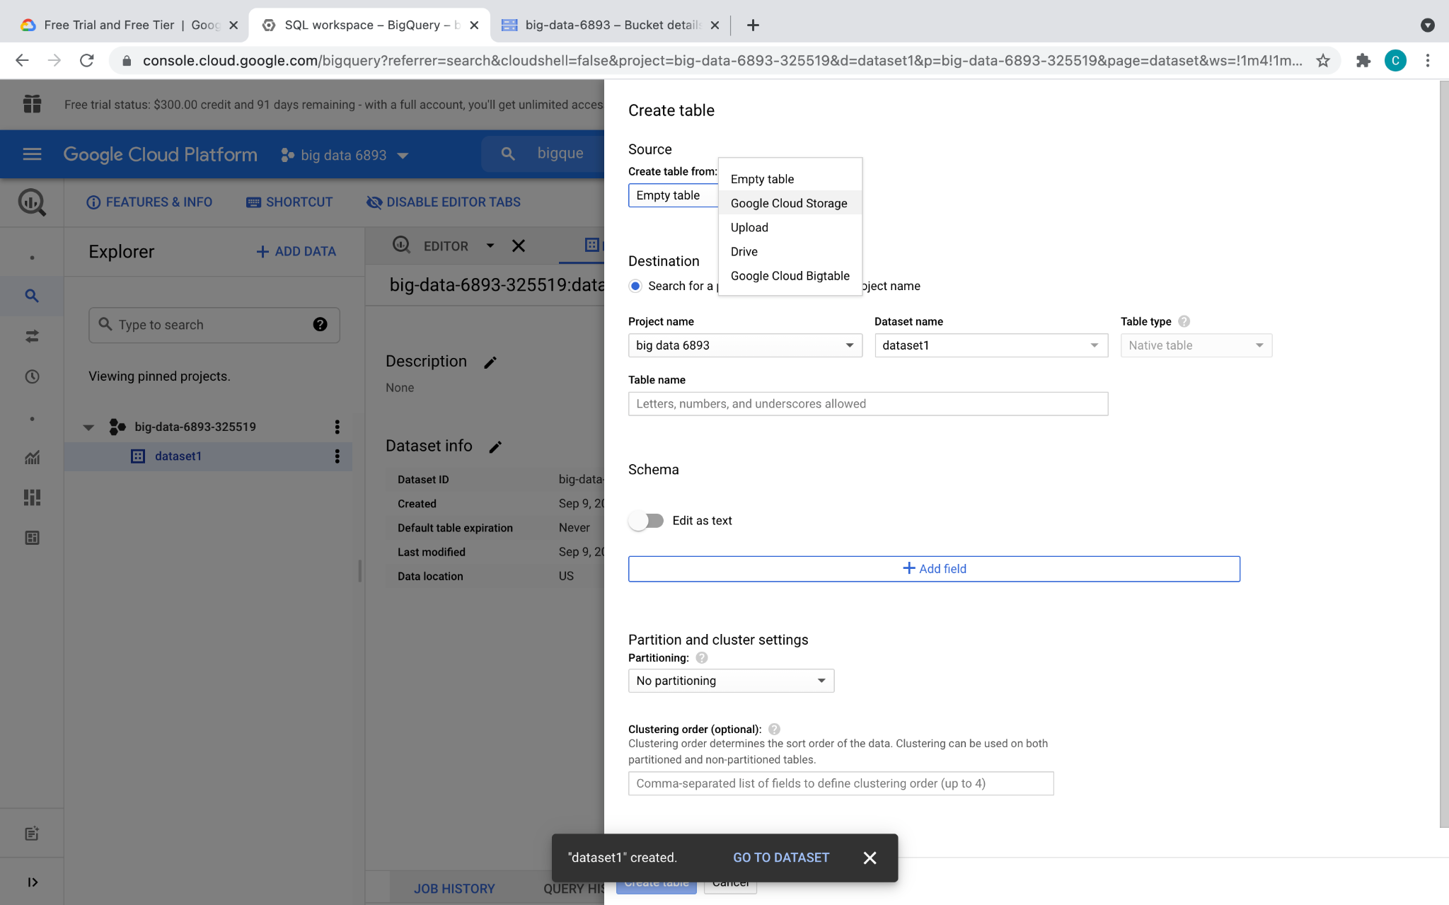
BigQuery

Slide 49
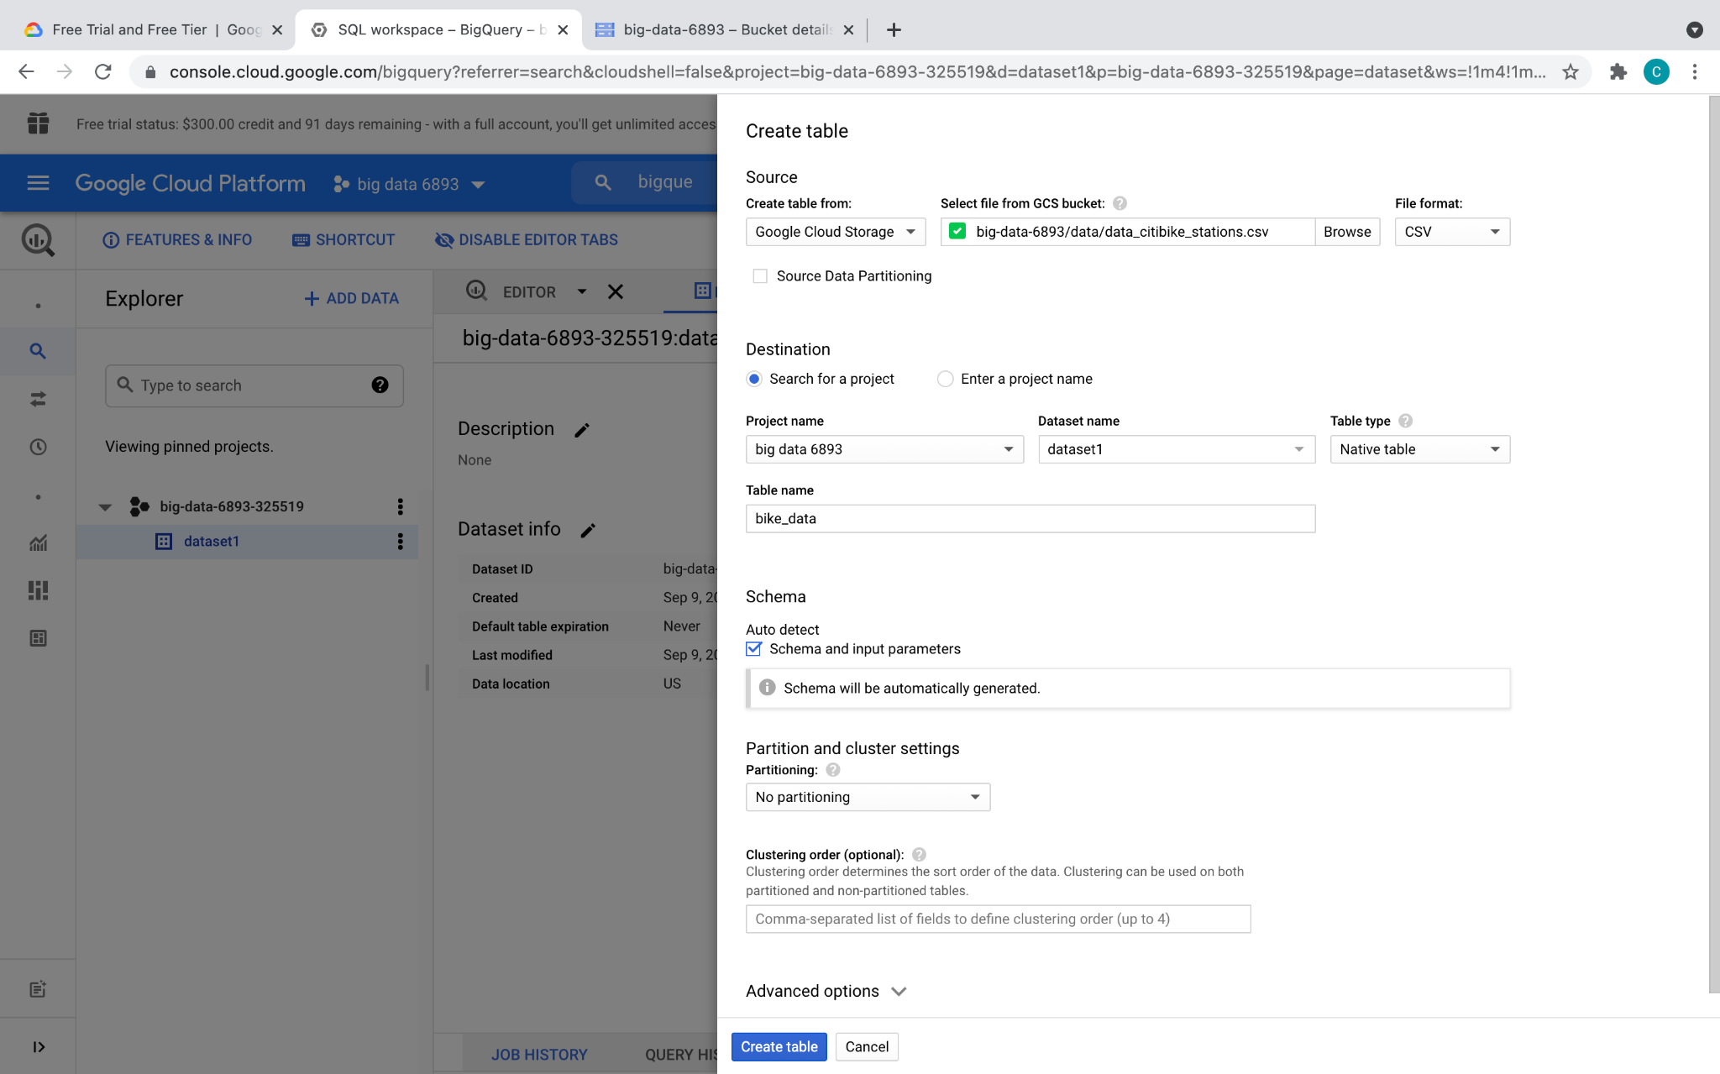

BigQuery

Slide 50
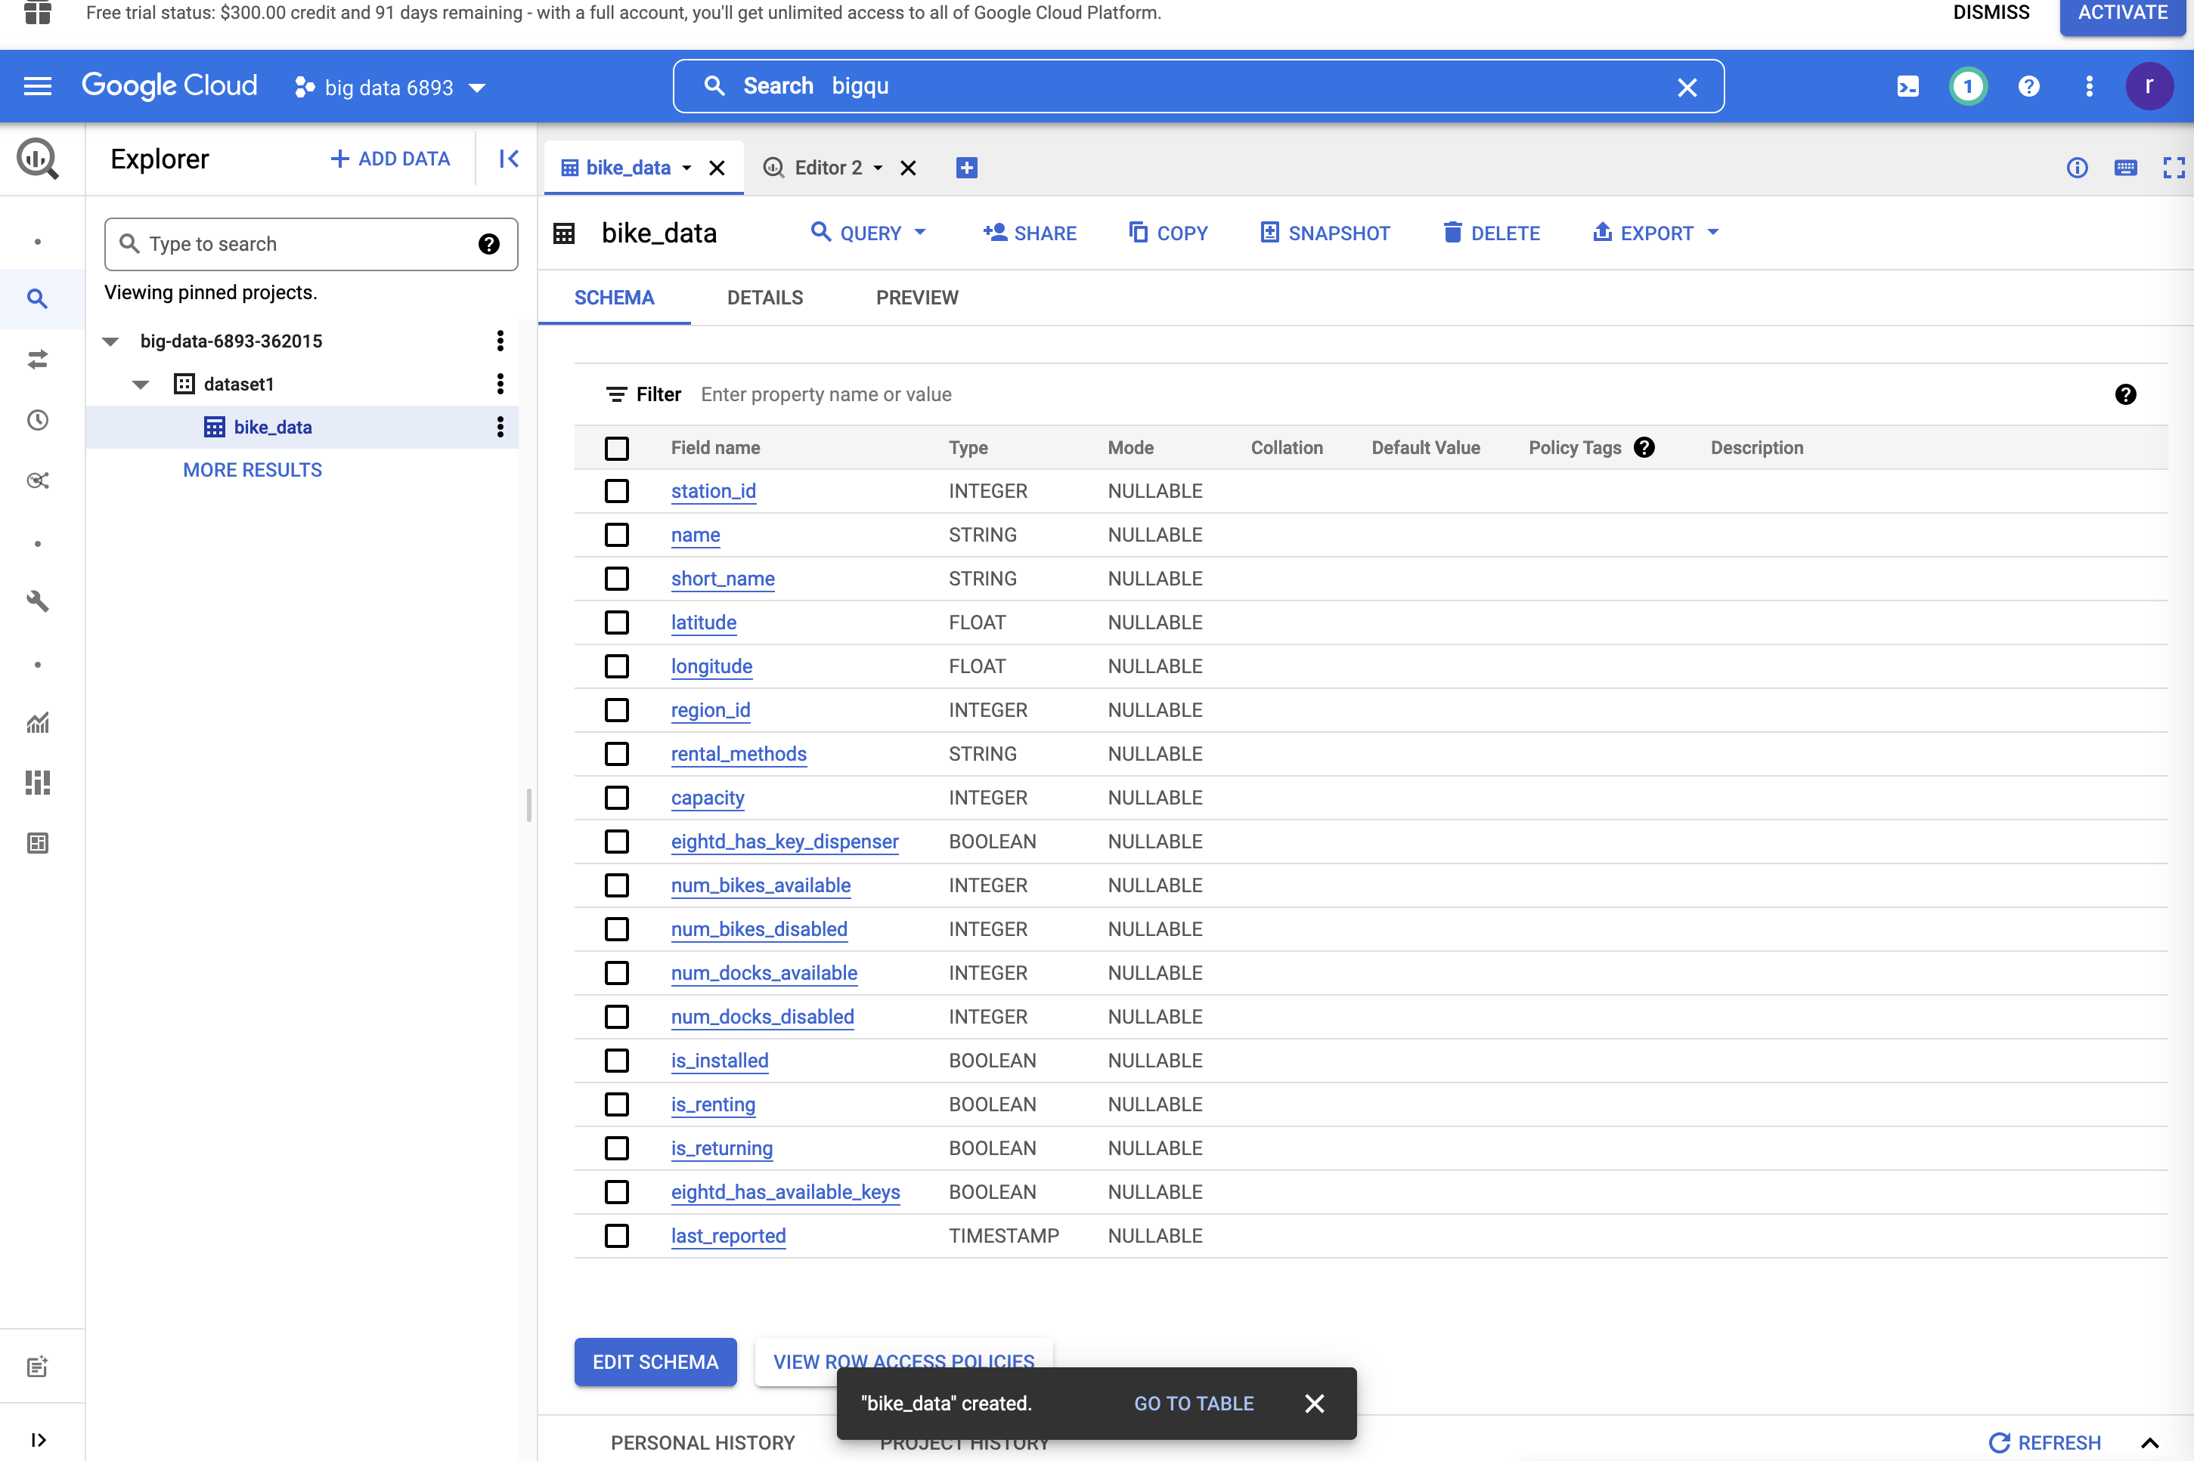
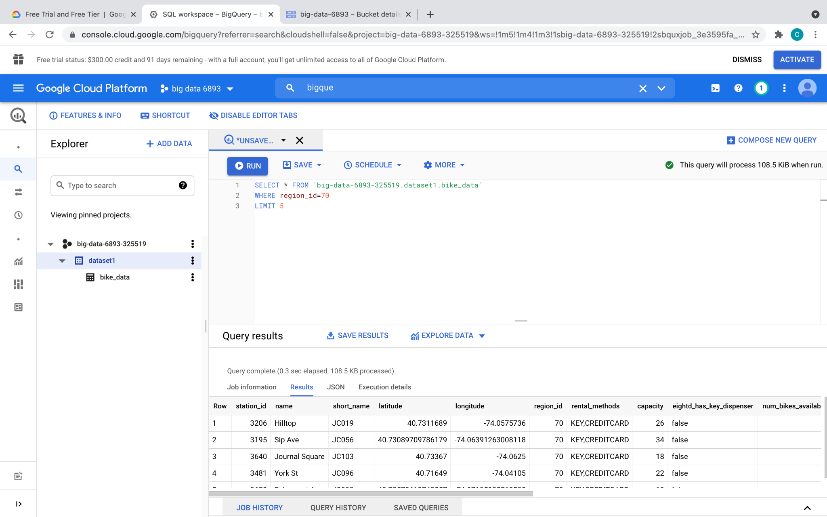

BigQuery

Slide 51

Dataproc

Slide 52

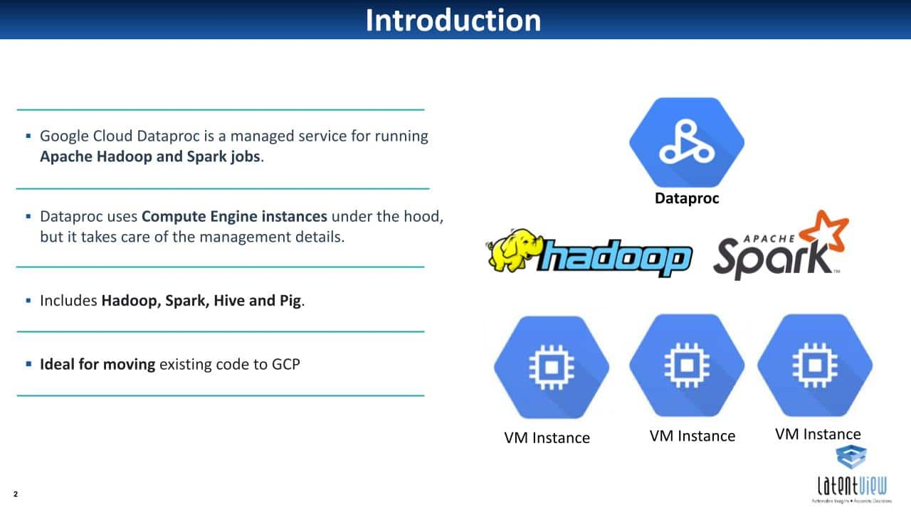
Dataproc
What is dataproc?

Slide 53
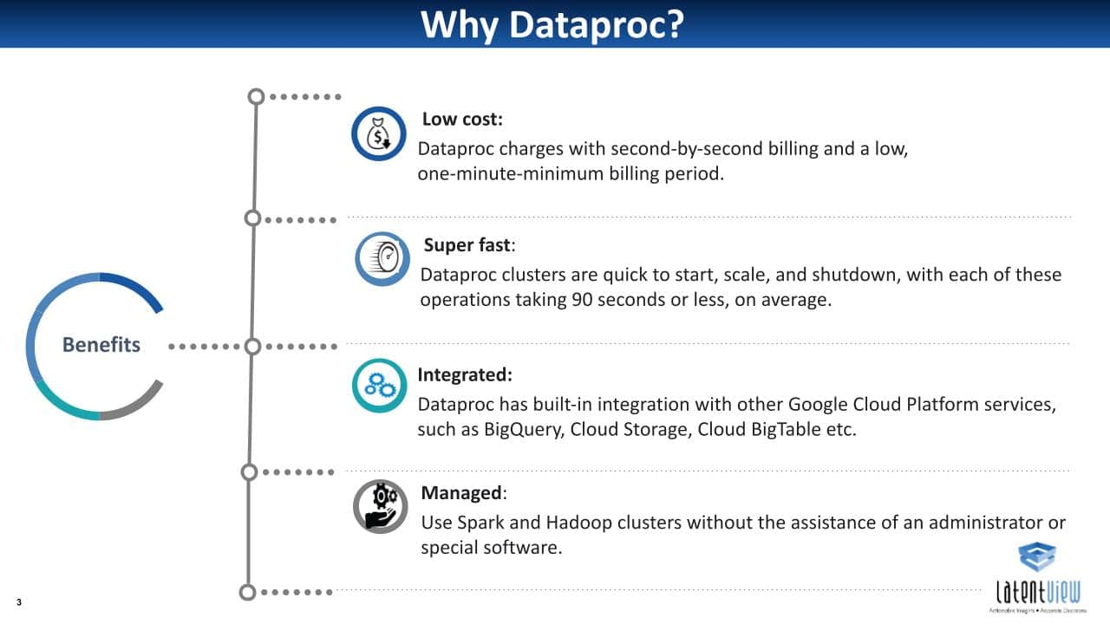
Dataproc
Why dataproc?

Slide 54
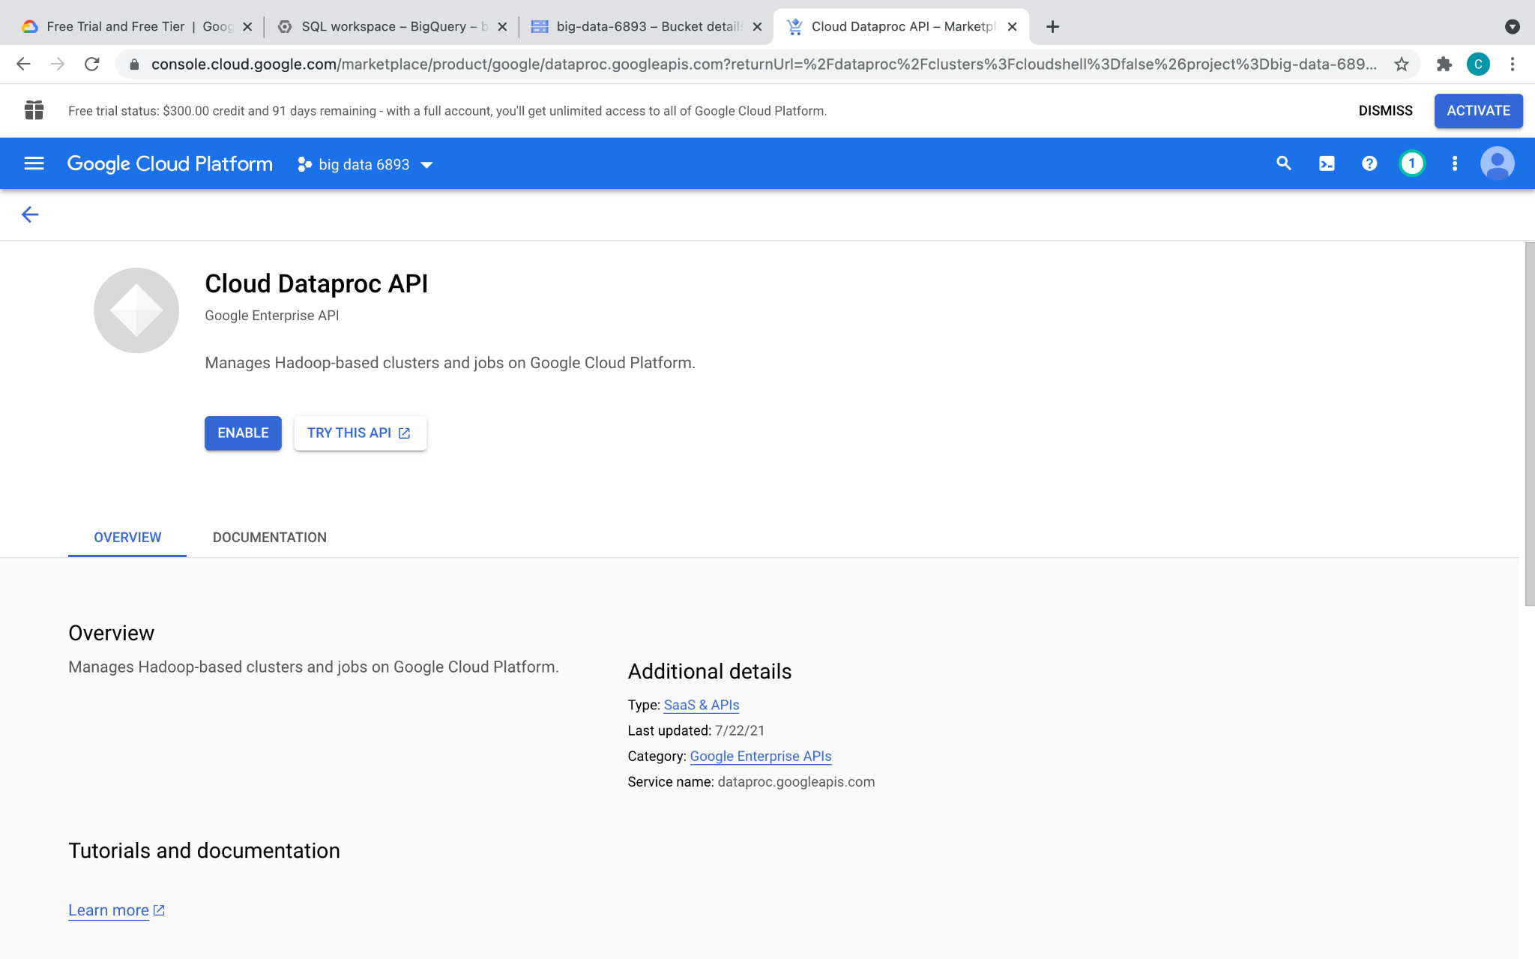
Dataproc
search cloud data proc
click on the API link

Slide 55

Dataproc - graphical UI
Go to Cloud Dataproc
Have not tested GKE, should also be OK

Slide 56


create cluster with Jupyter
(just pick Jupyter instead of Anaconda)
Then Click into the created cluster

Slide 57

Dataproc - Cloud SDK
Cluster creation (using Cloud SDK): (Instead of using GUI, command line tool can also be used to create Dataproc, recommended for Linux experts)
Notes:
gcloud dataproc clusters create example-cluster --region=us-east1

Slide 58

Dataproc - Cloud SDK
Cluster creation (using Cloud SDK):

Slide 59

Dataproc - Cloud SDK
Submit a job - Pi calculation
Notes:
gcloud dataproc jobs submit spark --cluster example-cluster --region=us-east1 --class org.apache.spark.examples.SparkPi --jars file:///usr/lib/spark/examples/jars/spark-examples.jar -- 1000

Slide 60

Dataproc - Cloud SDK
Submit a job - Pi calculation

Slide 61

Dataproc
On-demand, fully managed cloud service for running Apache Hadoop and Spark on GCP
Cluster creation (using Cloud SDK):
Automatically creates VMs with Spark pre-installed
Install Jupyter Notebook
Cloud Storage bucket: where your jupyter notebooks are saved
Works like pip install <your package>
Notes:
gcloud beta dataproc clusters create example-cluster --region=us-east1 --optional-components=ANACONDA,JUPYTER --image-version=1.3 --enable-component-gateway --bucket big-data-6893 --project big-data-6893-325519 --single-node --metadata 'PIP_PACKAGES=graphframes==0.6' --initialization-actions gs://dataproc-initialization-actions/python/pip-install.sh

Slide 62

Dataproc - Spark execution / submit jobs
Jupyter notebook:
Cloud SDK:
gcloud dataproc jobs submit pyspark <your_program.py> --cluster=<cluster-name>
View your jobs in console
Program could be Cloud Storage URI / local path / Cloud Shell path
Data should be on Cloud storage

Slide 63


Dataproc - Spark execution / submit jobs (cont’)
Spark shell
ssh into master node
pyspark

Slide 64
HW0
Read documentations and tutorials
Setup GCP and Cloud SDK
Familiar with BigQuery
Run Spark examples on Dataproc - Pi calculation and word count
Two light programming questions
BigQuery
Spark program - Find top k most frequent words
Remember to delete your dataproc clusters when you finish executions to save money.

